Slide 1
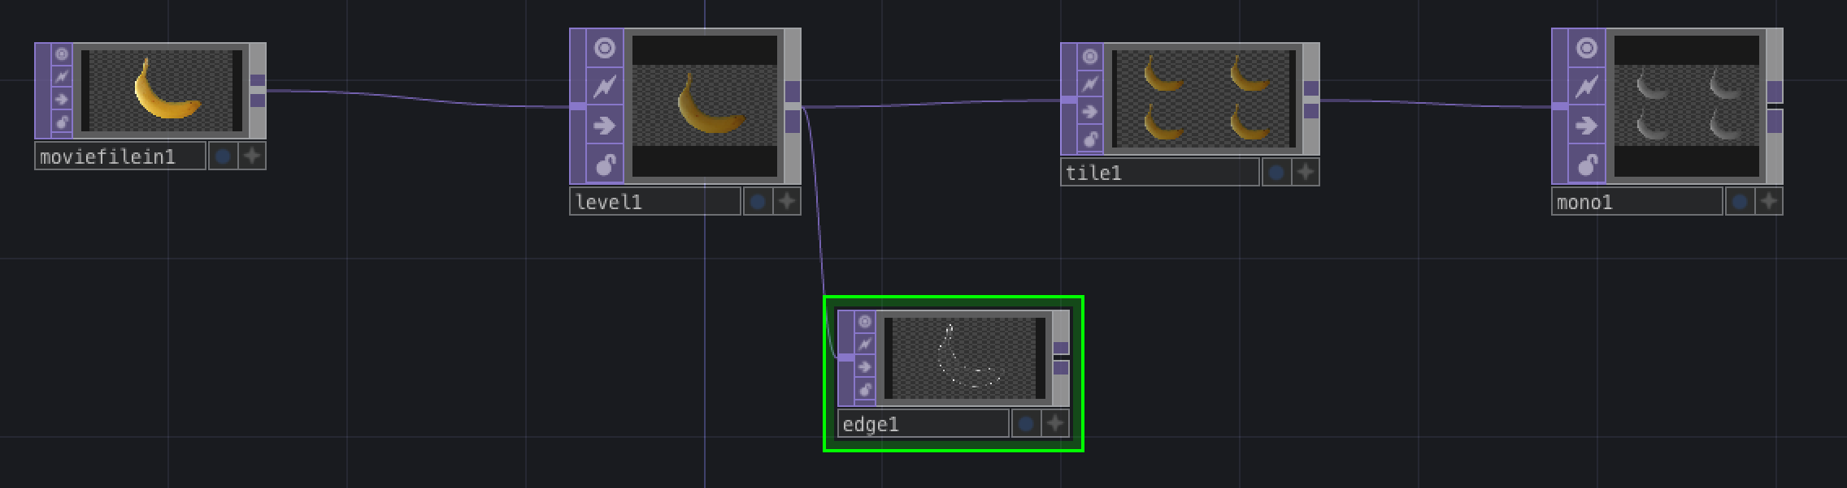
Introduction to TouchDesigner
David Meredith
dave@create.aau.dk

Slide 2
Some good sources of information
Getting started with TouchDesigner
https://derivative.ca/UserGuide/Getting_Started_With_TouchDesigner
First things to know about TouchDesigner
https://derivative.ca/UserGuide/First_Things_to_Know_about_TouchDesigner
Learning TouchDesigner
https://derivative.ca/UserGuide/Learning_TouchDesigner
User guide
https://derivative.ca/UserGuide/Main_Page
User guide in WIKI format
https://docs.derivative.ca/Main_Page
Scripting TouchDesigner with Python
https://docs.derivative.ca/Category:Python
Download page
https://derivative.ca/download
I’ll be using the non-commercial version
TouchDesigner glossary
https://derivative.ca/UserGuide/TouchDesigner_Glossary
Some useful introductory videos
https://derivative.ca/community-post/norway-workshop-videos-creative-projection-week-2016
More things to know about TouchDesigner
https://derivative.ca/UserGuide/More_Things_to_Know_about_TouchDesigner

Slide 3
Main source for this lecture
First things to know about TouchDesigner
https://derivative.ca/UserGuide/First_Things_to_Know_about_TouchDesigner

Slide 4
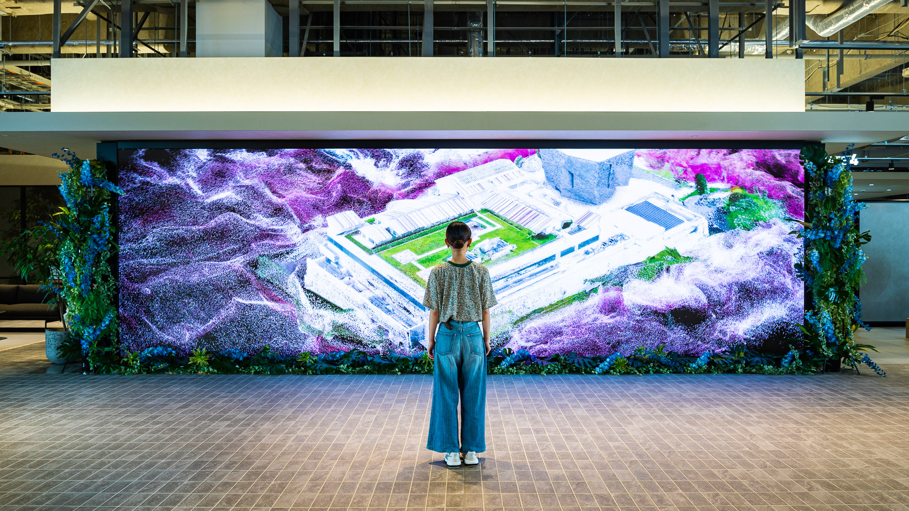
What is TouchDesigner and what can it do?
A visual programming environment for creating real-time interactive multimedia content
Can be used for
2D image and movie generation and filtering
Motion tracking, audio, animation and control signal processing
Realtime 3D surface processing and generation
Projection mapping
Application building (including building user interfaces)
High-performance media systems
Lighting and live shows
Creating virtual and augmented reality environments
Networking (with OSC)
… and much more
For examples of projects built using TouchDesigner, see, for example
https://derivative.ca/showcase

Slide 5
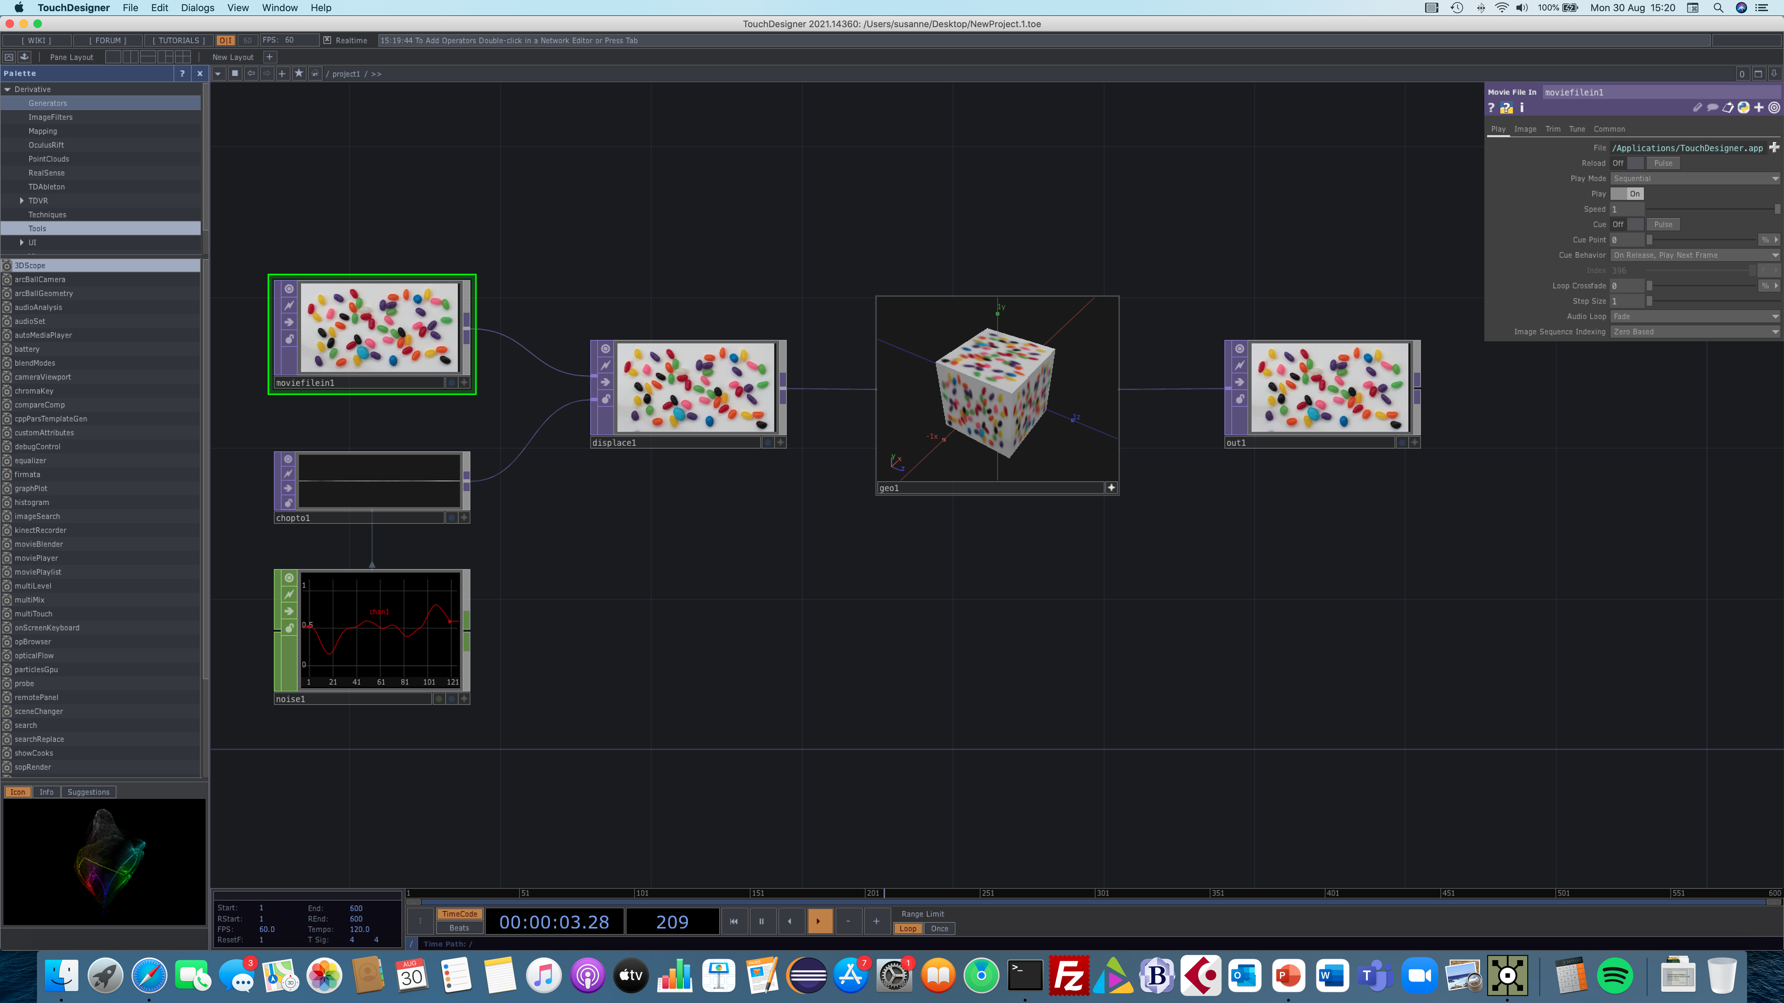
Getting started with TouchDesigner
Download TouchDesigner from the downloads page
https://derivative.ca/download
You can use the non-commercial version, you need to make an account so you can get a key after installation
Install in the obvious way
When using the first time, you’ll need to use the Key Manager Dialog to guide you through the process of getting a license
See https://derivative.ca/UserGuide/Install_TouchDesigner for troubleshooting installation

Slide 6
Starting TouchDesigner
Best to use a 3-button mouse, preferably with a roller wheel
When TD starts, you’ll see the build of your version on the splash dialog
Starts with a default network that is already running
You can pause the network by pressing the pause button
On the left is the Palette browser, which you can close with cross in its top right corner
The network consists of a number of operators that are wired together
One of the operators is selected and its parameters are shown in the dialog in the top right of the main window

Slide 7
Pan, zoom and center the network
Pan by clicking and dragging with the LMB on an empty area in the network
Zoom by rolling the middle roller or by holding the MMB and dragging left and right
You can also use Alt-right click if you don’t have a MMB
Home (center) entire network by pressing ‘h’
Use Shift-h to home just the highlighted node
Pressing the RMB on an empty area of the network brings up the network menu
You can zoom inside a component by continuing to zoom when it fills the screen

Slide 8
Selecting and moving nodes (operators)
Left-click and drag to move a node (its wires go with it)
Right-click in an empty area of the network and drag to box select one or more nodes
Left-click on one of the selected node to move all of them in parallel
Right-click on a node to get its node menu
Only get node menu if node’s viewer is not active
You can bring up a separate view window for a node by right clicking and selecting “View”
You can interact with the View window by zooming, dragging, tumbling, etc.
Delete a node by selecting it and pressing delete

Slide 9
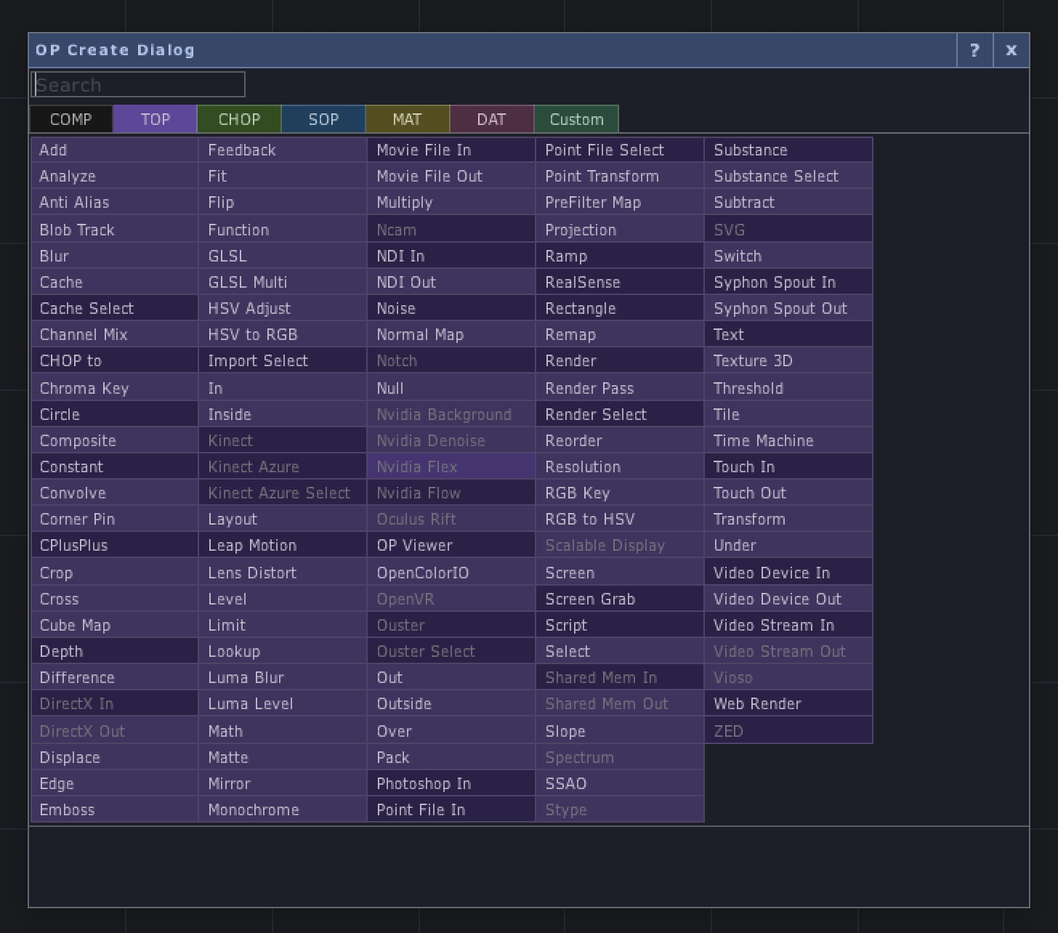
Operators are either generators or filters
If we double-click on an empty network, we get the OP Create Dialog
“OP” is short for “operator”
Another word for operator is “node”
OPs with a darker background are generators (e.g., Movie File In)
Generators create new data or import data from files, programs or devices
Ops with lighter background are filters (e.g., Level)
Filters modify the data from an incoming operator

Slide 10
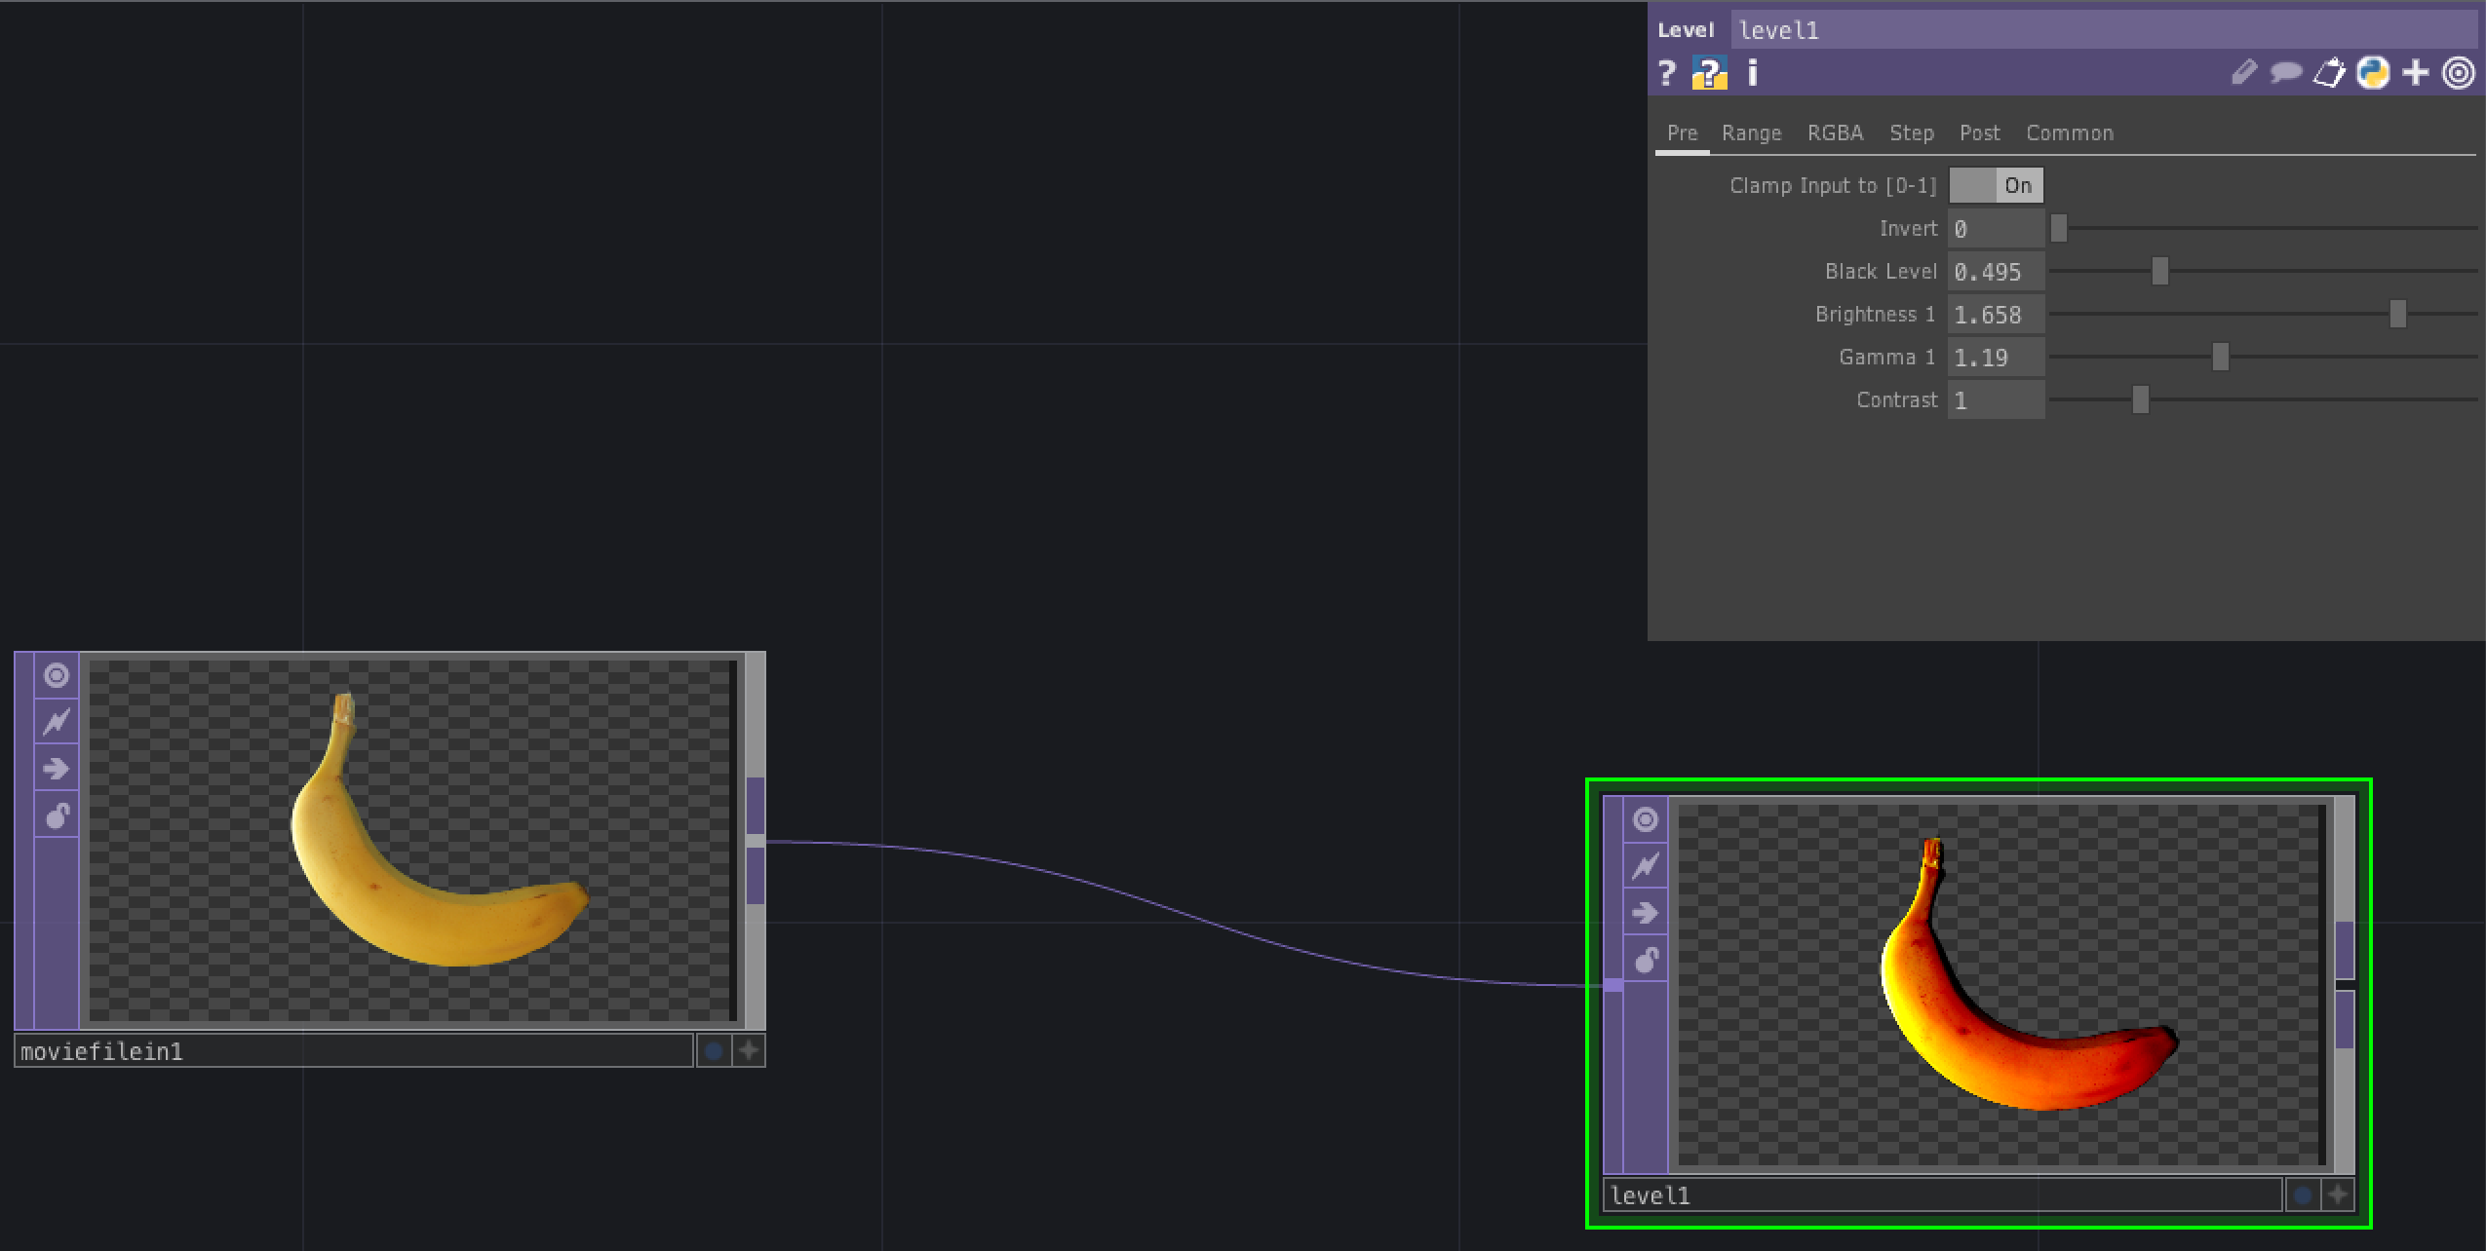
Adding an image generator and a filter
Use the OP Create Dialog to add a Movie File In operator to an empty network
Right click its right-hand connector, which brings up the OP Create Dialog again, and select the Level OP, which is a filter
You now have a generator operator (moviefilein1) sending its output to a filter (level1)
Play with the sliders in the parameters dialog in the top right of the screen to see the effect that the Level filter has on the image that is imported using the Movie File In operator

Slide 11
Operator families
There are six families of operators, shown on different pages in the OP Create Dialog
COMP – Components: Object components (3D objects), panel components (2D UI gadgets) and misc components
Components contain other operators
TOPs – Texture Operators: 2D image operations
CHOPs – Channel Operators: motion, audio, animation, control signals
SOPs – Surface Operators: 3D points, polygons and other 3D primitives
MATs – Material Operators: materials and shaders
DATs – Data Operators: operators containing text, such as scripts, XML, tables

Slide 12
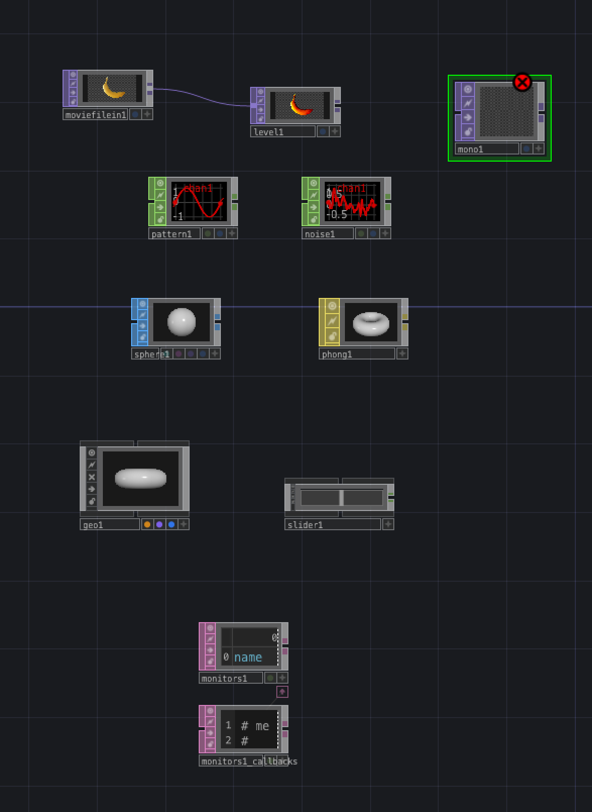
Adding operators
Let’s add some operators from different families
Monochrome TOP
Pattern and Noise CHOPs
Sphere SOP
Phong MAT
Geometry COMP (prepares SOP and MAT for 3D rendering)
Slider COMP (a 2D gadget for building control panels)
Monitors DAT

Slide 13
Connecting nodes with wires
Inputs on the left, outputs on the right
Connect output of level1 to mono1
Left-click on output of level1, release, left-click on input to mono1
Or left-click on output, drag and release on input
Create a Tile TOP and insert between the Level and Monochrome TOPs
Right click output of level1 and select Tile TOP
Create a new branch by right clicking on anexisting wire and selecting “Add operator”
Add an Edge TOP as a second output from the level1 TOP
Remove a wire by clicking on its destination input and then on empty space in network
Can also right click on wire and select “Disconnect”

Slide 14
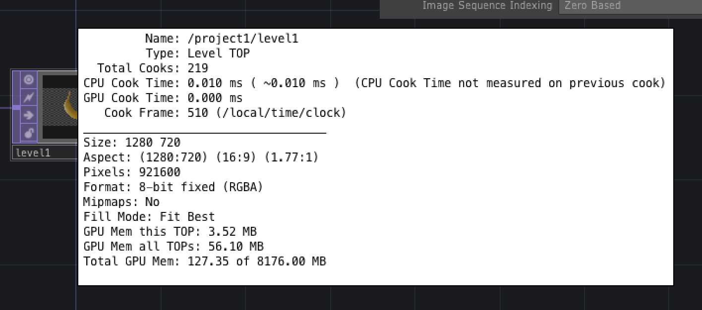
Wires, data flow and cooking
Data flows along wires from node outputs to node inputs
For example, when select level1 TOP and adjust its parameters, data flows out of its output node to tile1 and edge1
You can see the wires animate while the data is flowing
Data flows through a wire when an upstream node is cooking (i.e., doing some computation)
Middle click on a node to bring up its Info dialog
Info dialog shows how many times a node has cooked, e.g., tile1 had cooked many times, but moviefilein1 has only cooked once
Can also bring up Info dialog by right clicking on a node and selecting “Info” from the pop-up menu

Slide 15
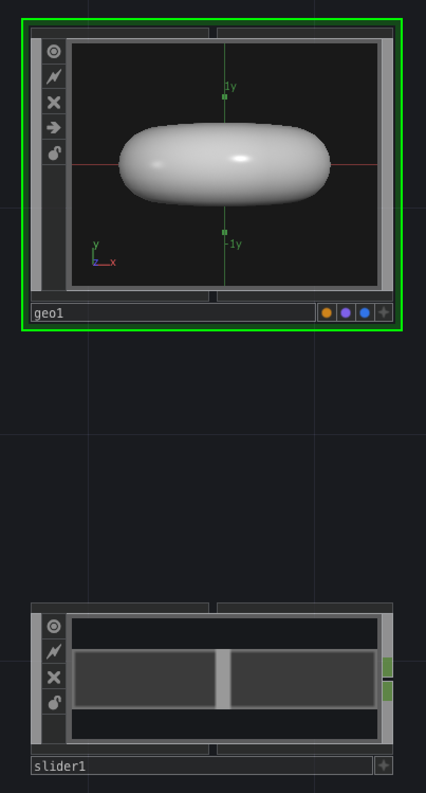
Top and bottom connectors
3D components have connectors on their tops and bottoms that can be used to arrange them into a hierarchy
2D components also have these connectors – in this case, they are used to arrange them into control panels
No data flows along these top and bottom connectors – data only flows through the inputs and outputs on the sides of the nodes

Slide 16
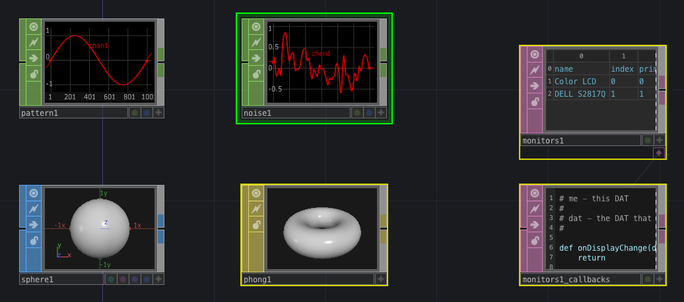
Current nodes and selected nodes
Clicking on a node gives it a green border and makes it the “current” node
Selected nodes that are not the current node have yellow borders (e.g., when you box select several nodes)
You can apply a single operation simultaneously to all selected nodes (e.g., delete them)
You can undo the previous operation with Ctrl-Z (or Cmd-Z on a Mac)

Slide 17
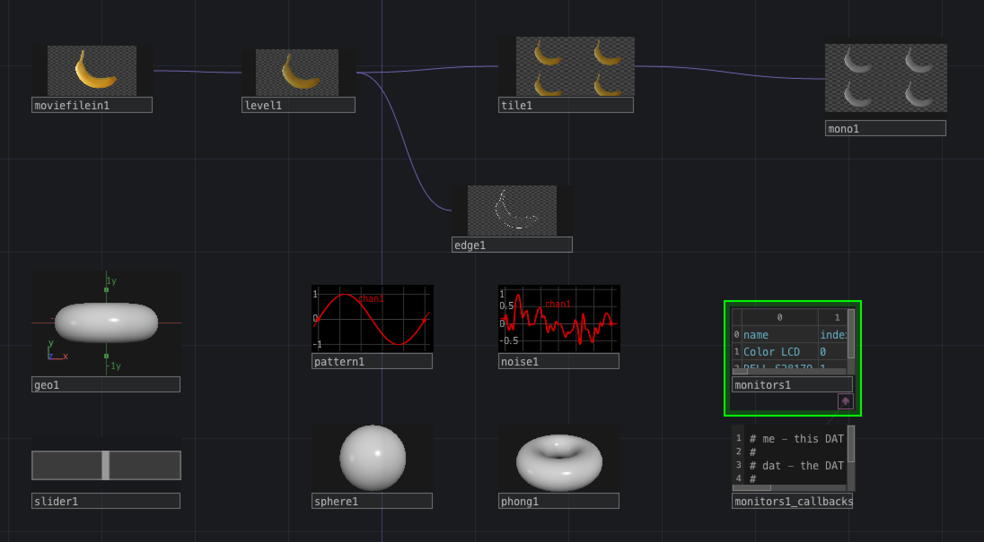
Node viewers
If you click Viewer active flag, then border is removed and you can interact with content of node and inspect content more closely
Middle click and drag left/right to zoom content of node
Right click to get a menu of viewing options
Alt-A or Option-A puts all node viewers temporarily into Viewer Active state
Can make all viewers active by selecting “Viewers always active” from the right-click network menu
Pressing ‘a’ toggles viewer active flag for selected node
When a node has its viewer active, you can access its menus and move it around by clicking on its name bar at the bottom

Slide 18
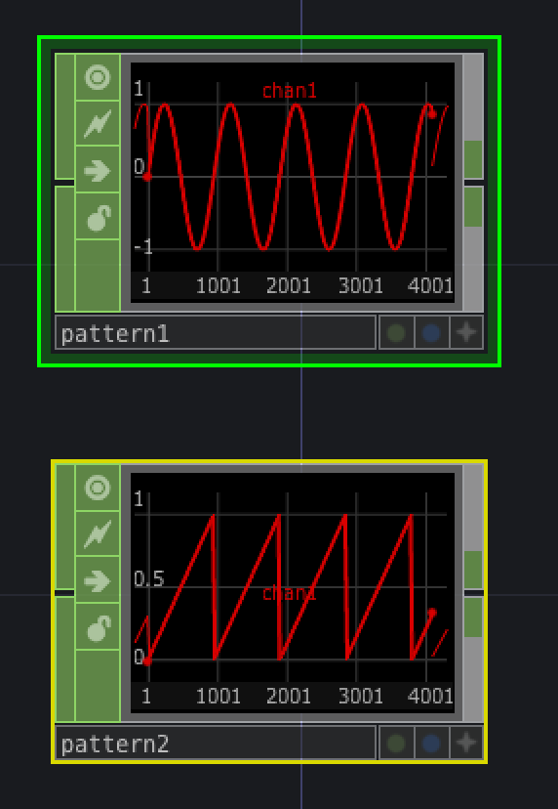
Adjusting node parameters
Parameter dialog in top right-hand corner shows parameter values for the currently selected node
You can hide or show it by pressing ‘p’
You can also show parameters of a node by right clicking and selecting “Parameters…”
Can change value of same parameter in multiple selected nodes
Make a copy of pattern1 and make the new Pattern node’s type “Ramp”
Select pattern1 and pattern2
Change the value of the “Number of cycles” parameter
To reset a single parameter to its default value, right click on the parameter in the Parameter dialog and select “Reset parameter”
To reset all parameters to their default values, right click and select “Reset all parameters”

Slide 19
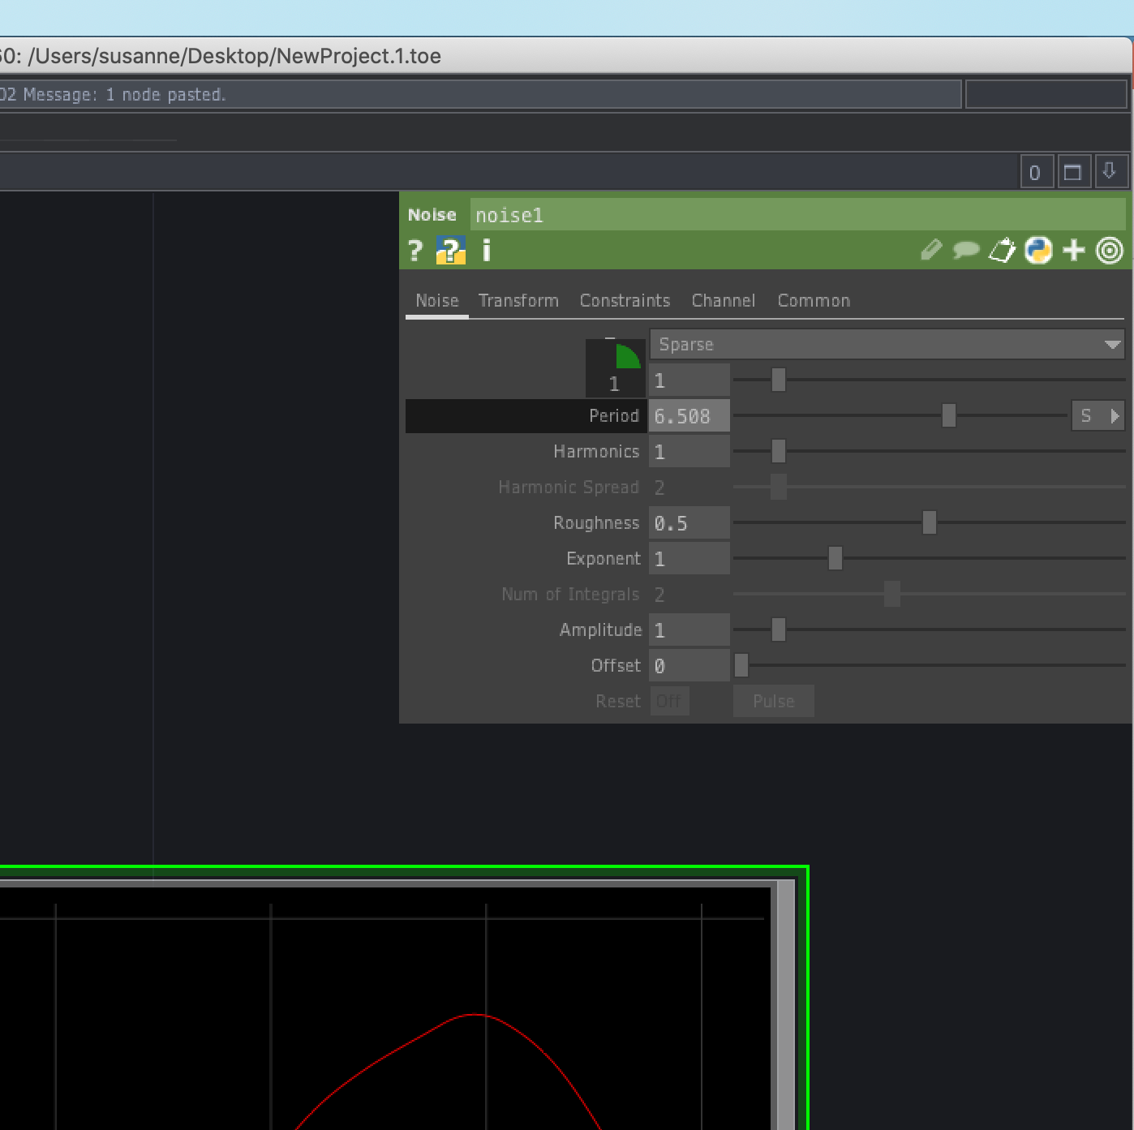
Value ladders
You may find value ladders useful for changing the values of parameters
Left-click on a parameter name in the Parameter dialog and wait a moment – a value ladder appears
You can also bring up the value ladder immediately by middle-clicking on the name of a parameter
Select one of the values in the ladder to choose the order of magnitude
Then drag left or right to ”fine-tune” the value

Slide 20
Value ladders for multi-dimensional parameters
If you click on a single component of a multi-dimensional parameter, then the value ladder changes just the value of that component
If you click on the name of a multi-dimensional parameter, then the value ladder changes all the components for that parameter

Slide 21
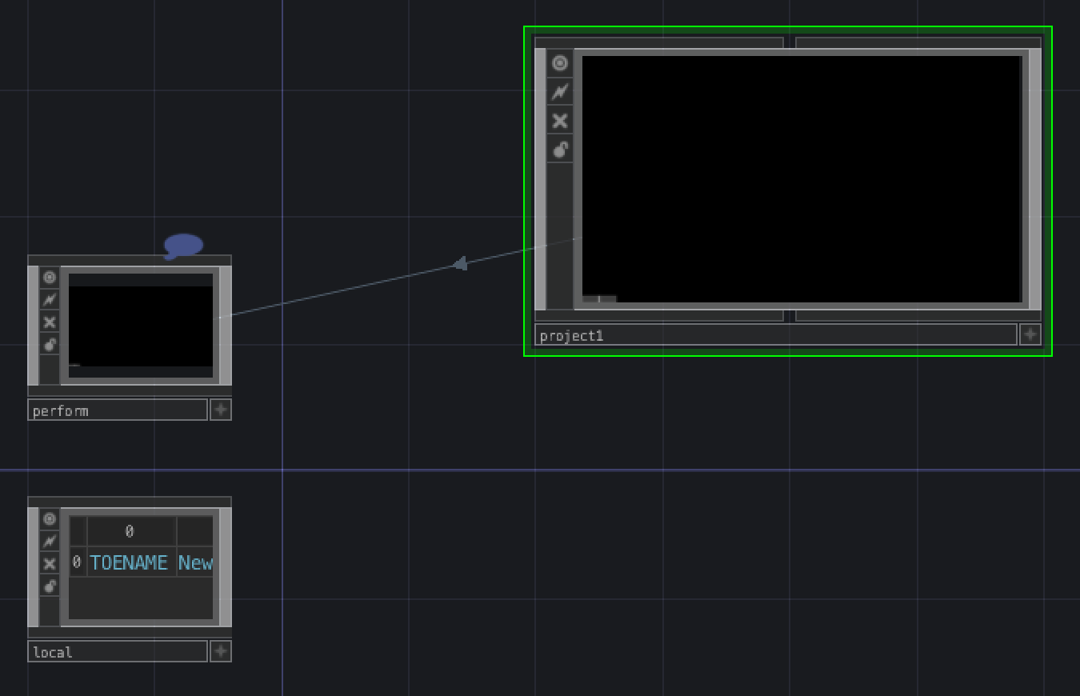
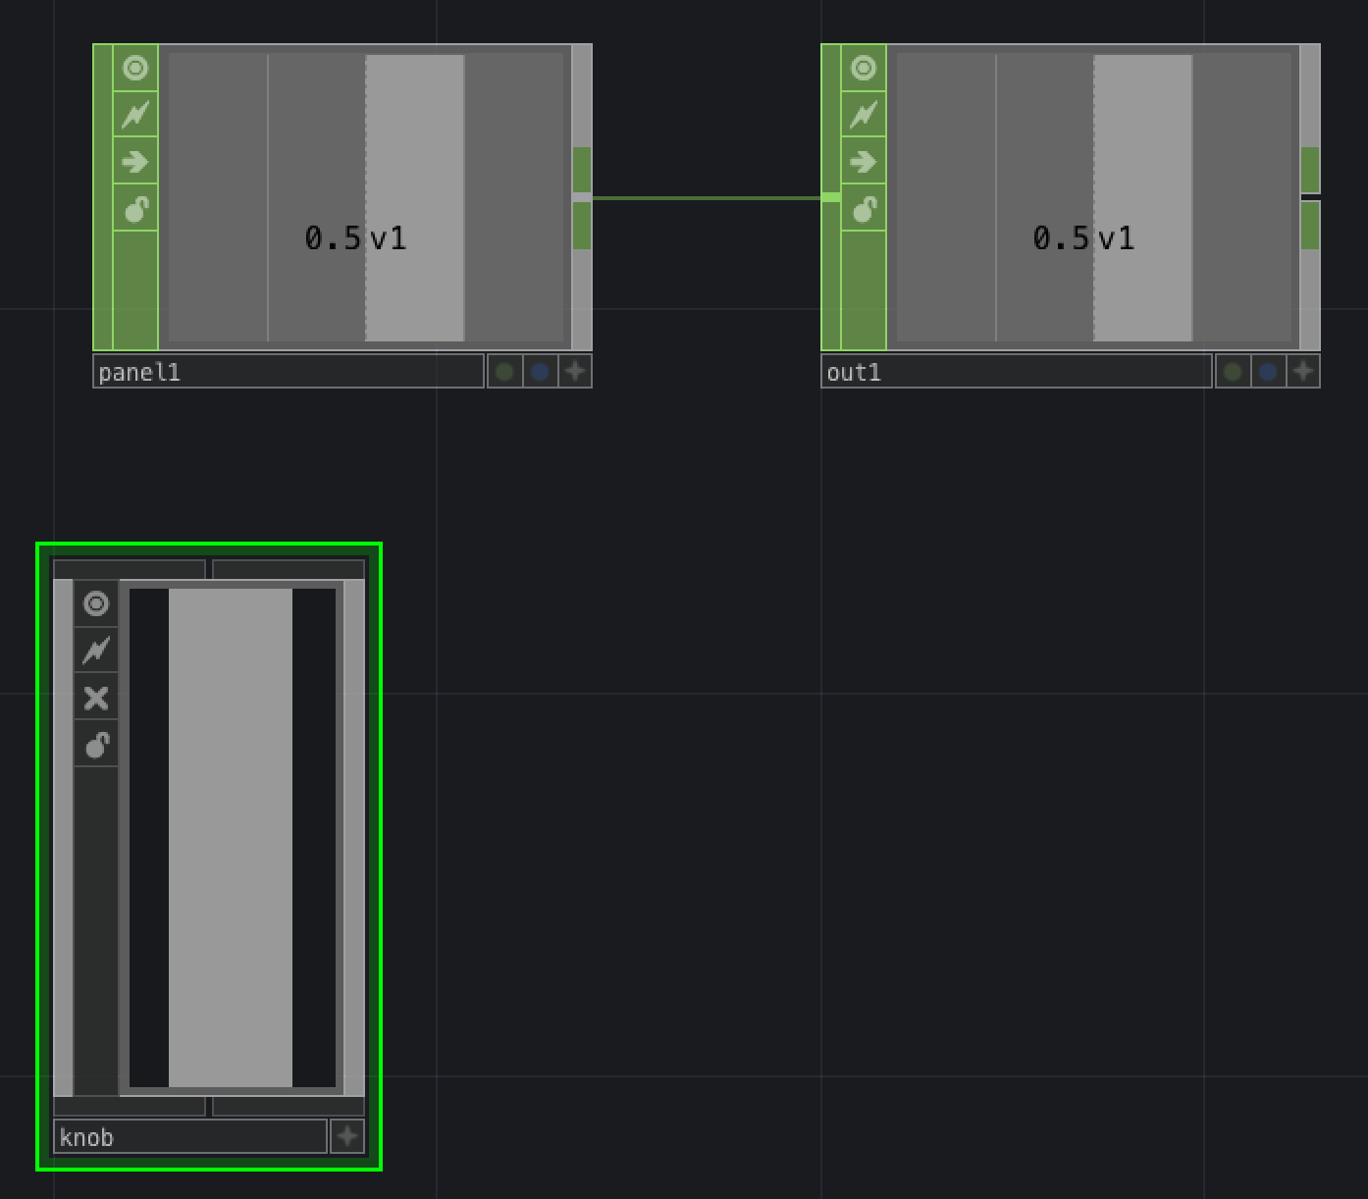
Components
A Component node contains a network
Every network lives inside a Component
If you zoom out far enough, you go outside the project node that contains the network that you’ve been editing
If you zoom into the project1 node, you re-enter the network that you were editing before
If you zoom into a component node, then you go inside it and enter the network that it contains
Try this with the geo1 or slider1 components
You can go inside a selected component by pressing ‘i’ (for ‘inside’)
You can get out of a component by pressing ‘u’ (for ‘up’)
You can also enter a component by double clicking it so long as its viewer is not active

Slide 22
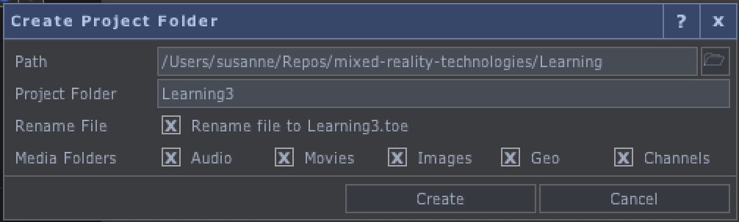
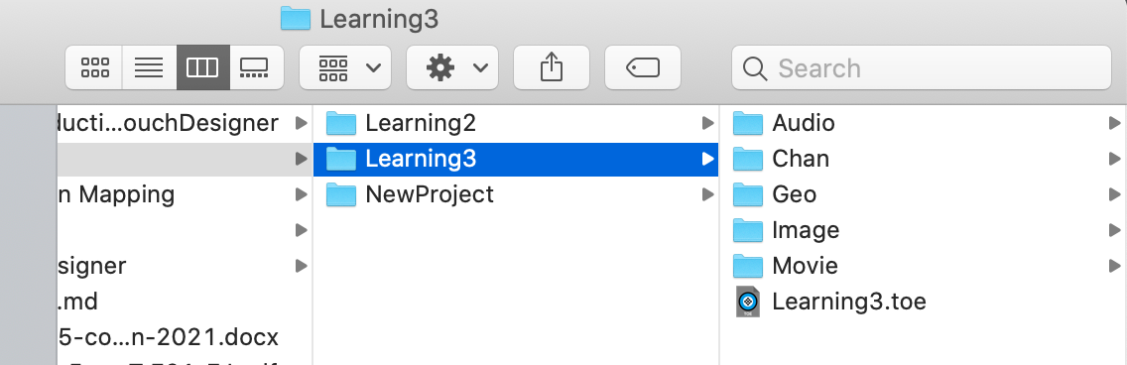
Remember to save your work frequently
When creating a new project, you can choose to have TD create folders for the different types of files that might be present in your project

Slide 23
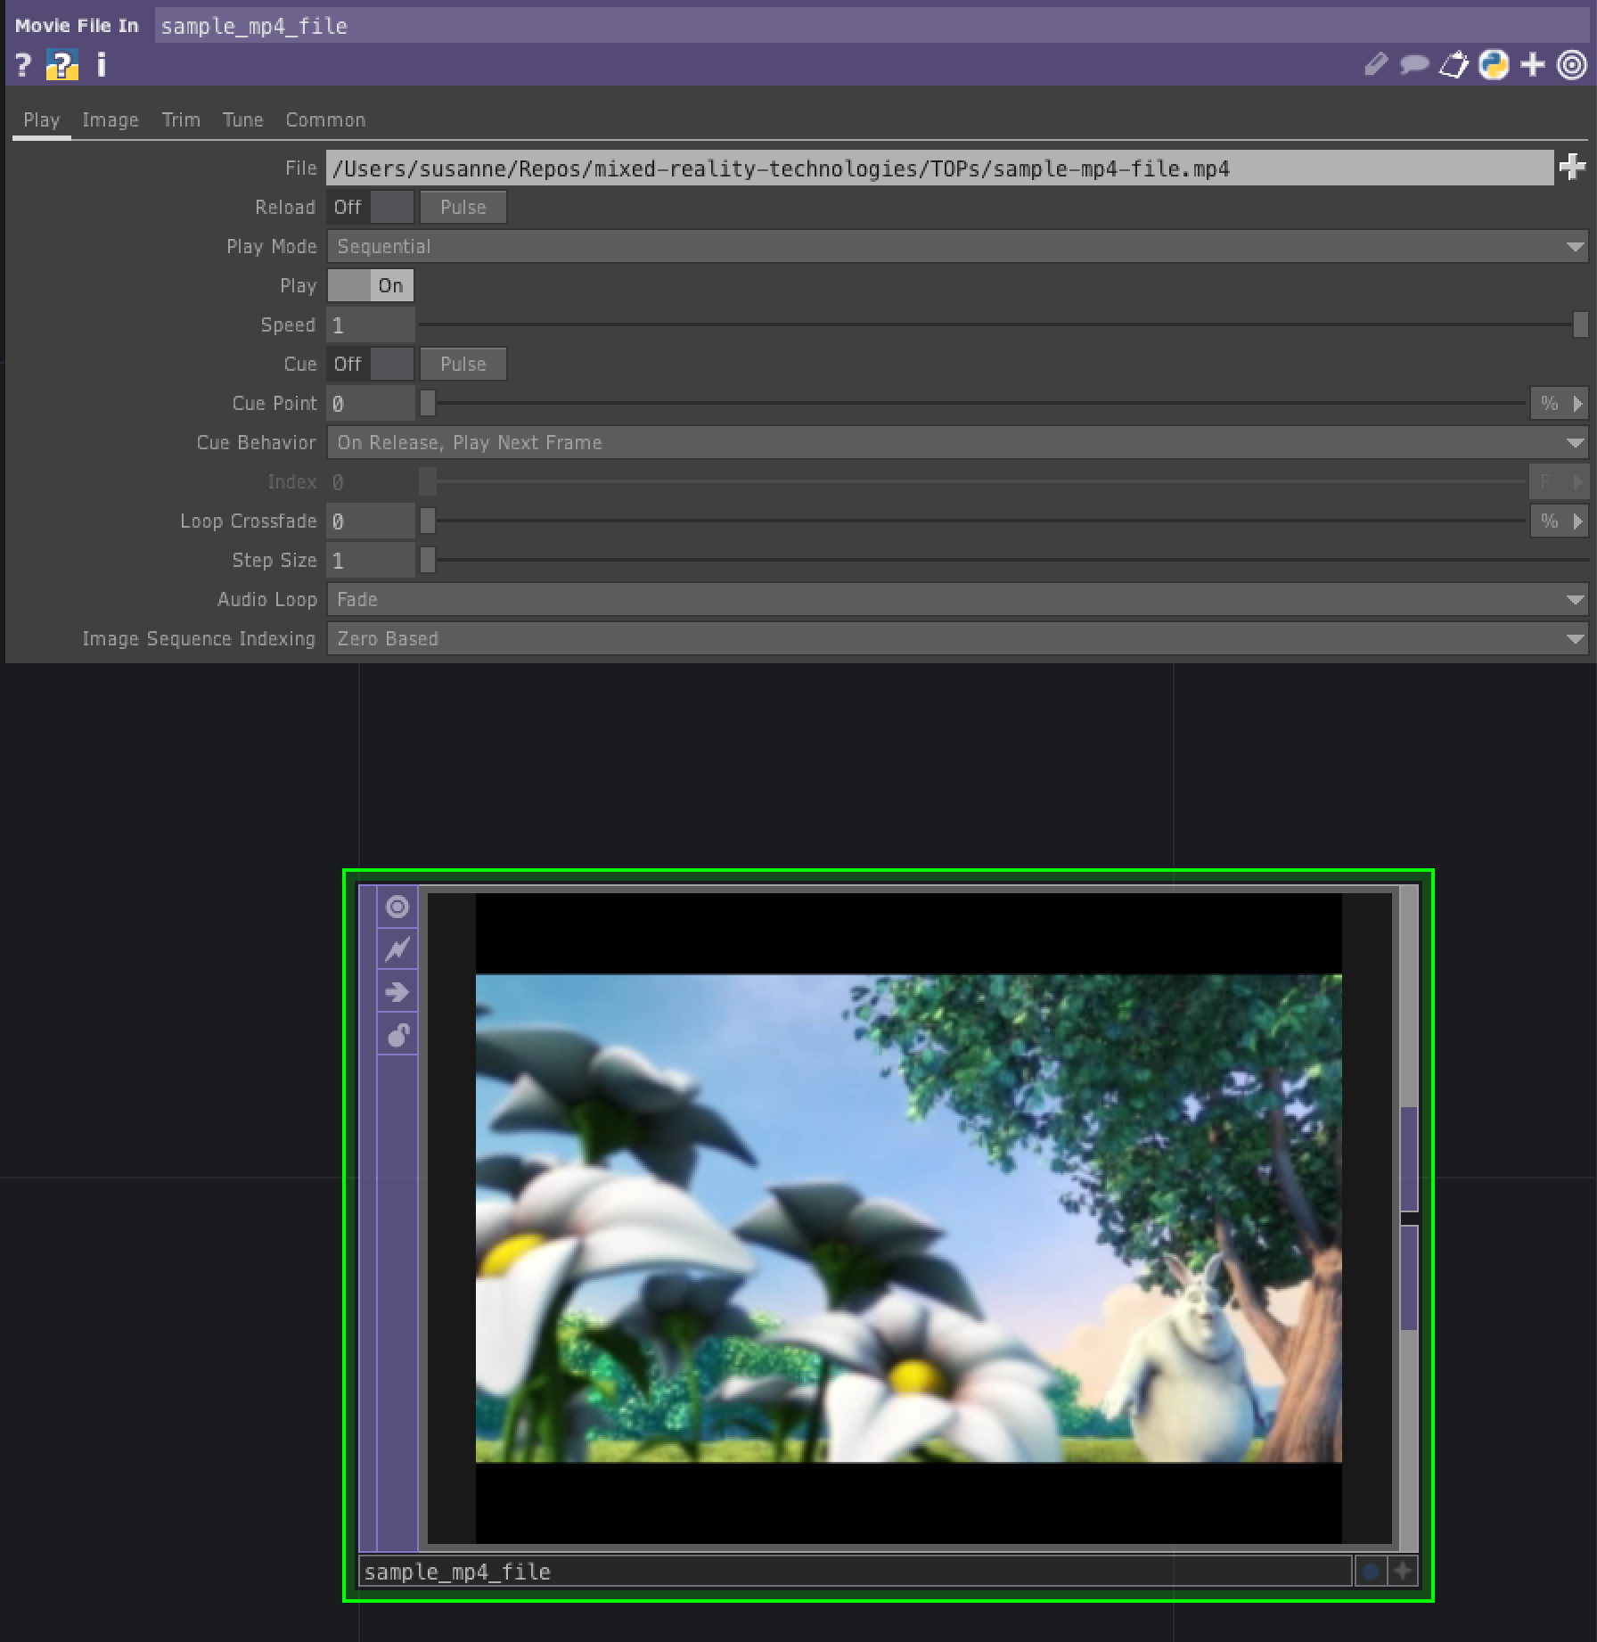
Getting media into TouchDesigner
You can import images, movies, audio, FBX and TouchDesigner Components (TOX files) into TouchDesigner
See https://derivative.ca/UserGuide/File_Types for details about what file formats are accepted
You can simply drag images, movies and audio files from your Finder or File Explorer directly into a network
You can also place a Movie File In TOP in your network and then enter the path to the file that you want to import into its “File” parameter
You can also open a media file from the Explorer/Finder into TouchDesigner, but this will start a new instance of TD and open the file in an appropriate node

Slide 24
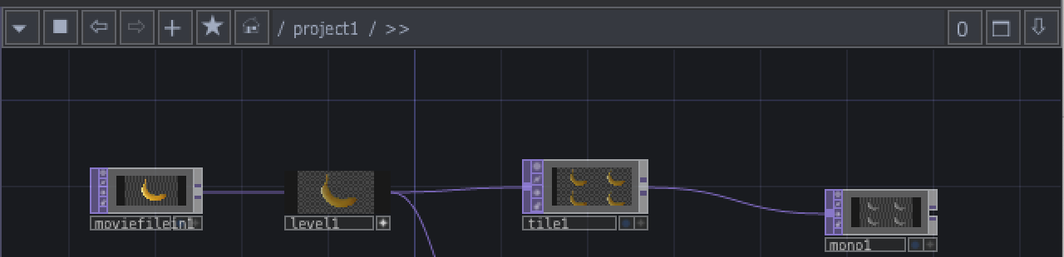
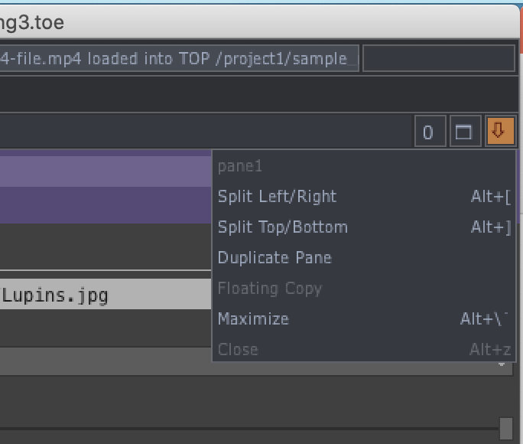
Split panes and pane types
At top of every pane is the Pane bar
Split pane menu
Maximise pane
Link pane menu
Network path shows location within network
Pane type on left allows you to change the type of a pane
Network editor is what we’ve been using
Panel type lets you interact with the panel components (e.g., sliders)
Geometry viewer lets you interact with 3D scenes and objects

Slide 25
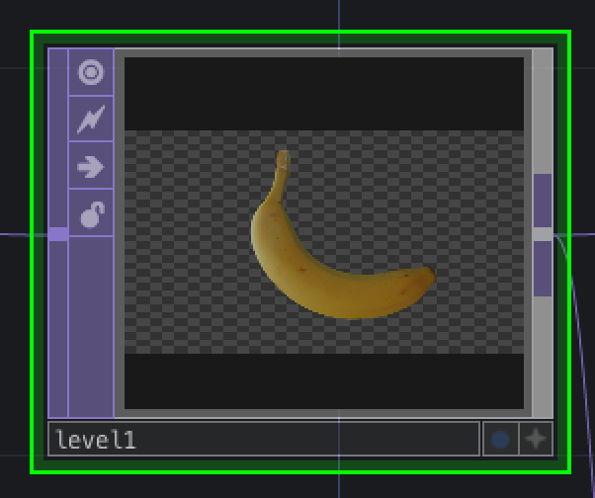
Flags
3-letter code
Clone immune
Bypass
Lock
Display
Viewer active

Slide 26
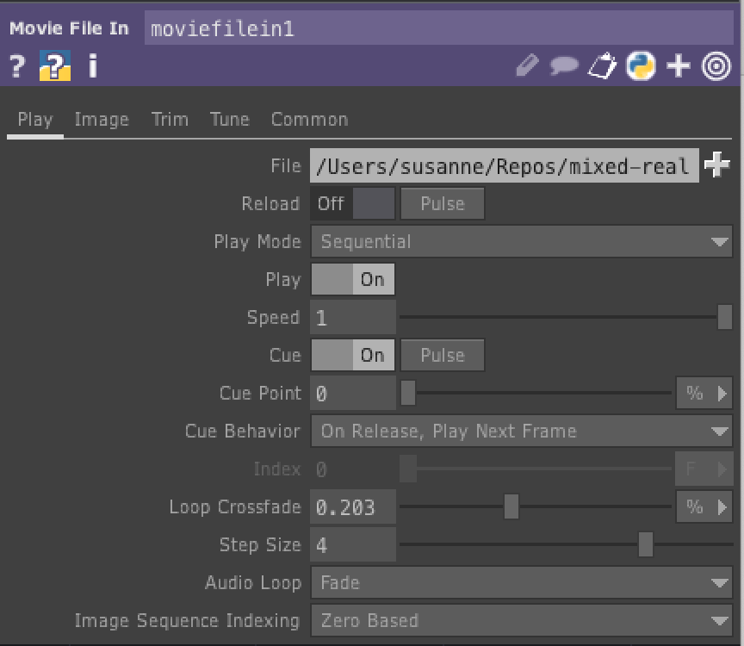
Parameters
Operators process and output data
Output of an operator depends on inputs, parameters and possibly current time
Common types of parameters are integers, floating point values, Boolean toggles, menus, text strings, node paths, pulses that tell an operator to do something just once
A parameter may be a unidimensional value or it might be an array of 2, 3 or 4 values
E.g., a color is an array of either 3 or 4 values: red, green, blue and possibly alpha

Slide 27
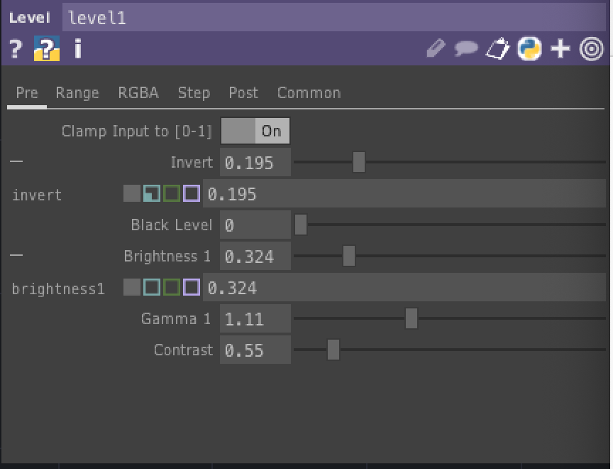
Parameter modes
Each parameter is in one of 4 different modes
Constant mode: a specific constant value, entered either by typing the value or by using a slider or selecting a value from a drop-down list
Expression mode: can be a python expression
Export mode: values come from import from a CHOP
Binding mode: causes the values of two or more parameters to bound so that changing one of them changes all of them

Slide 28
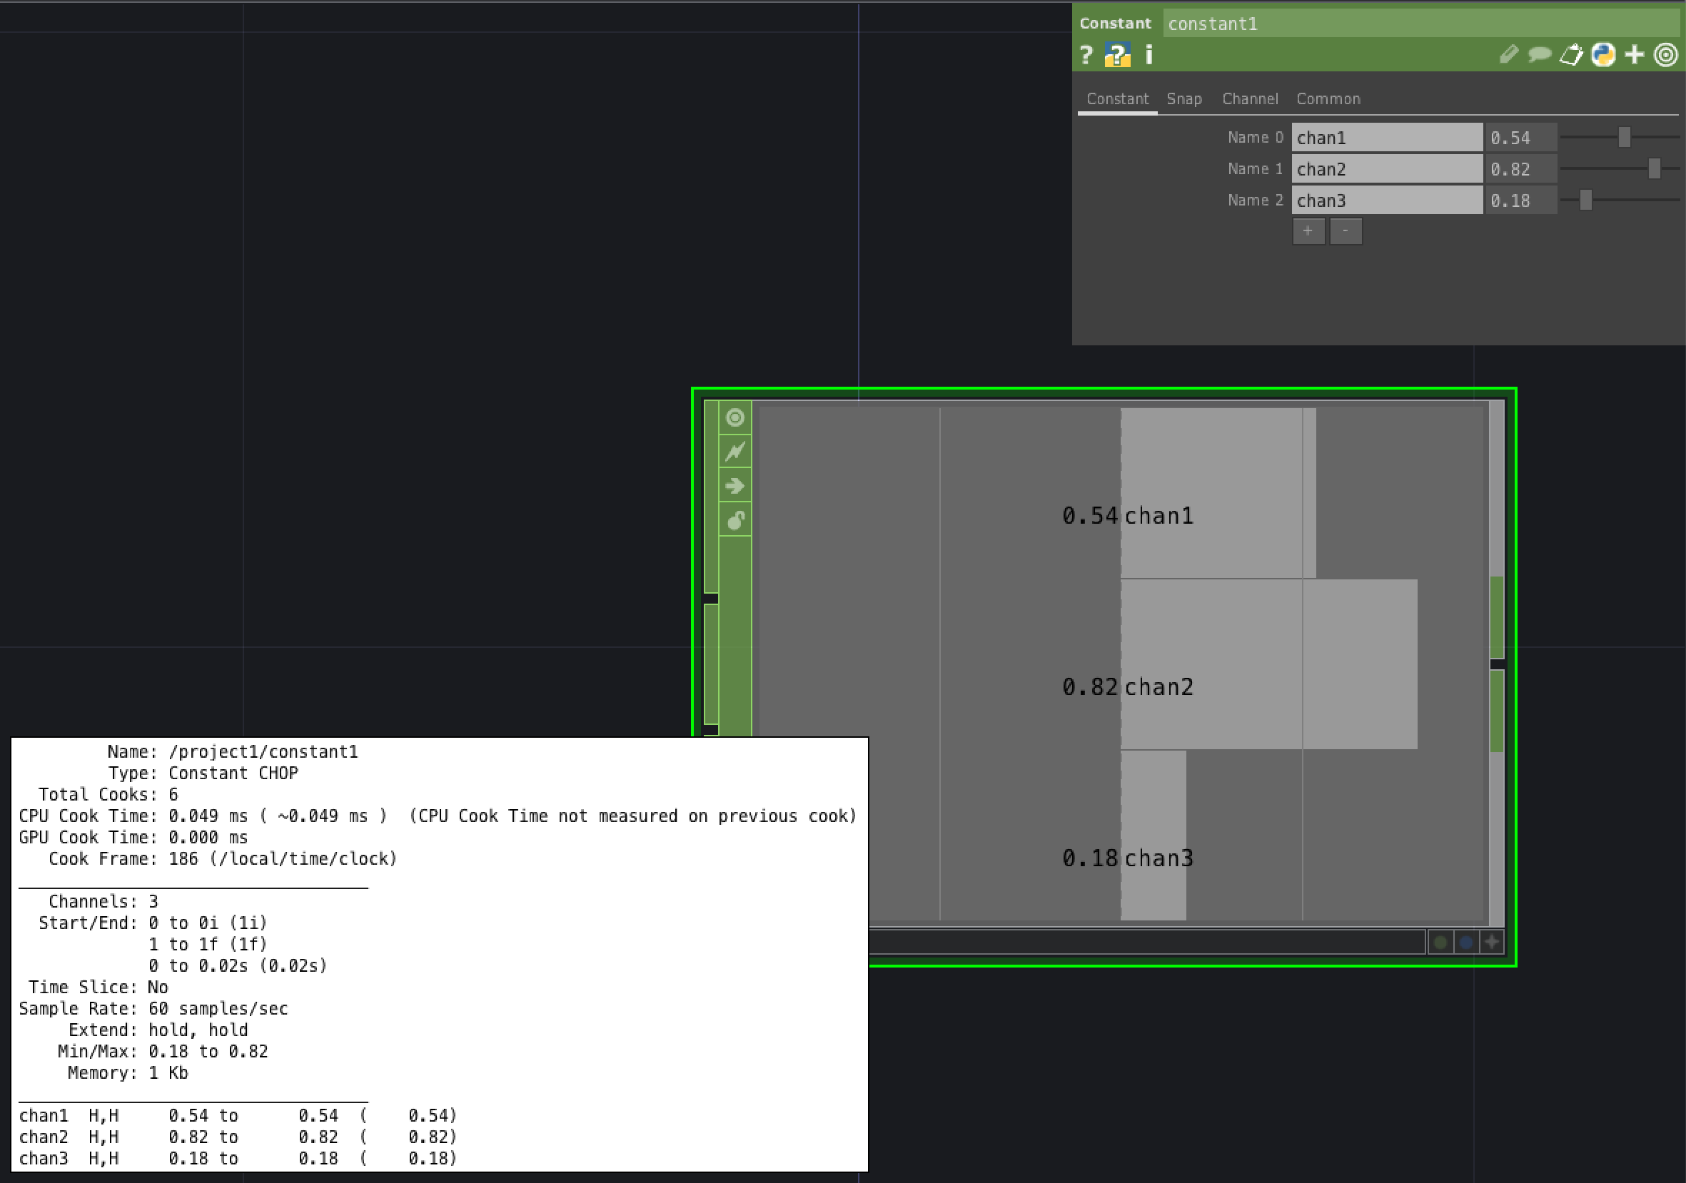
CHOPs (Channel Operators) output streams of numbers
A channel operator (CHOP) generates one or more channels, each of which is a sequence of numbers, called samples
For example, a constant CHOP has 1 channel and 1 sample
You can add additional channels to a Constant CHOP
Middle click on the Constant CHOP to bring up its info dialog
See that there are 3 channels and each channel has 1 value

Slide 29
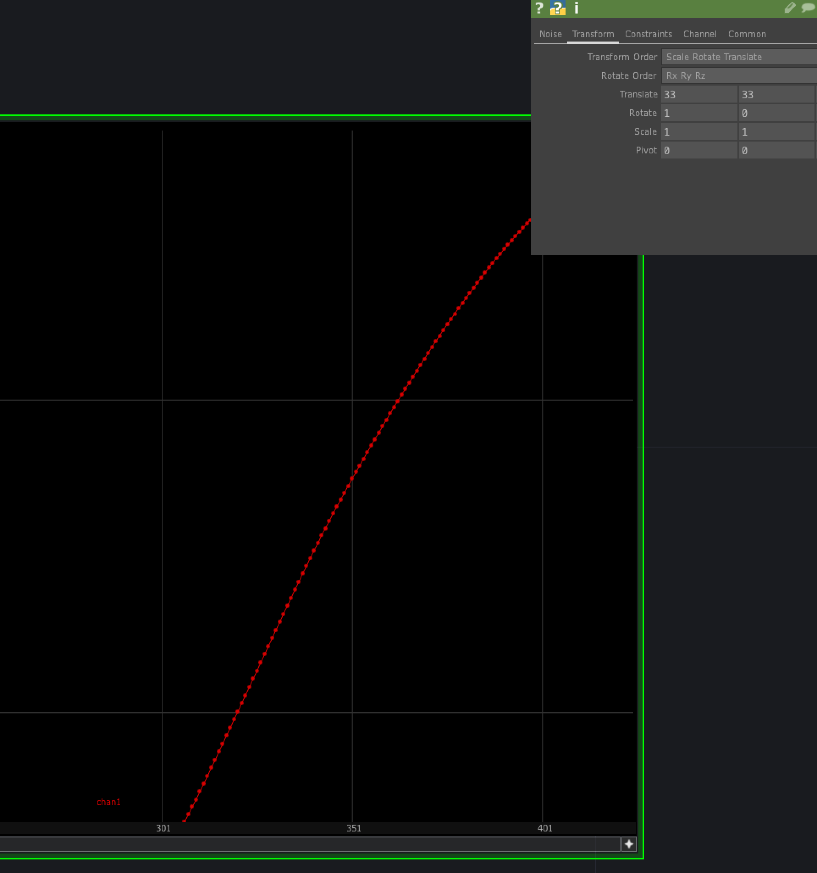
Noise CHOP generates multiple values
A Noise CHOP generates a single channel with many samples
Make viewer active
Right click and select “Dot per Sample”
Zoom in to see dots, which represent the separate values in the channel
Press in Viewer active mode to home the channel

Slide 30
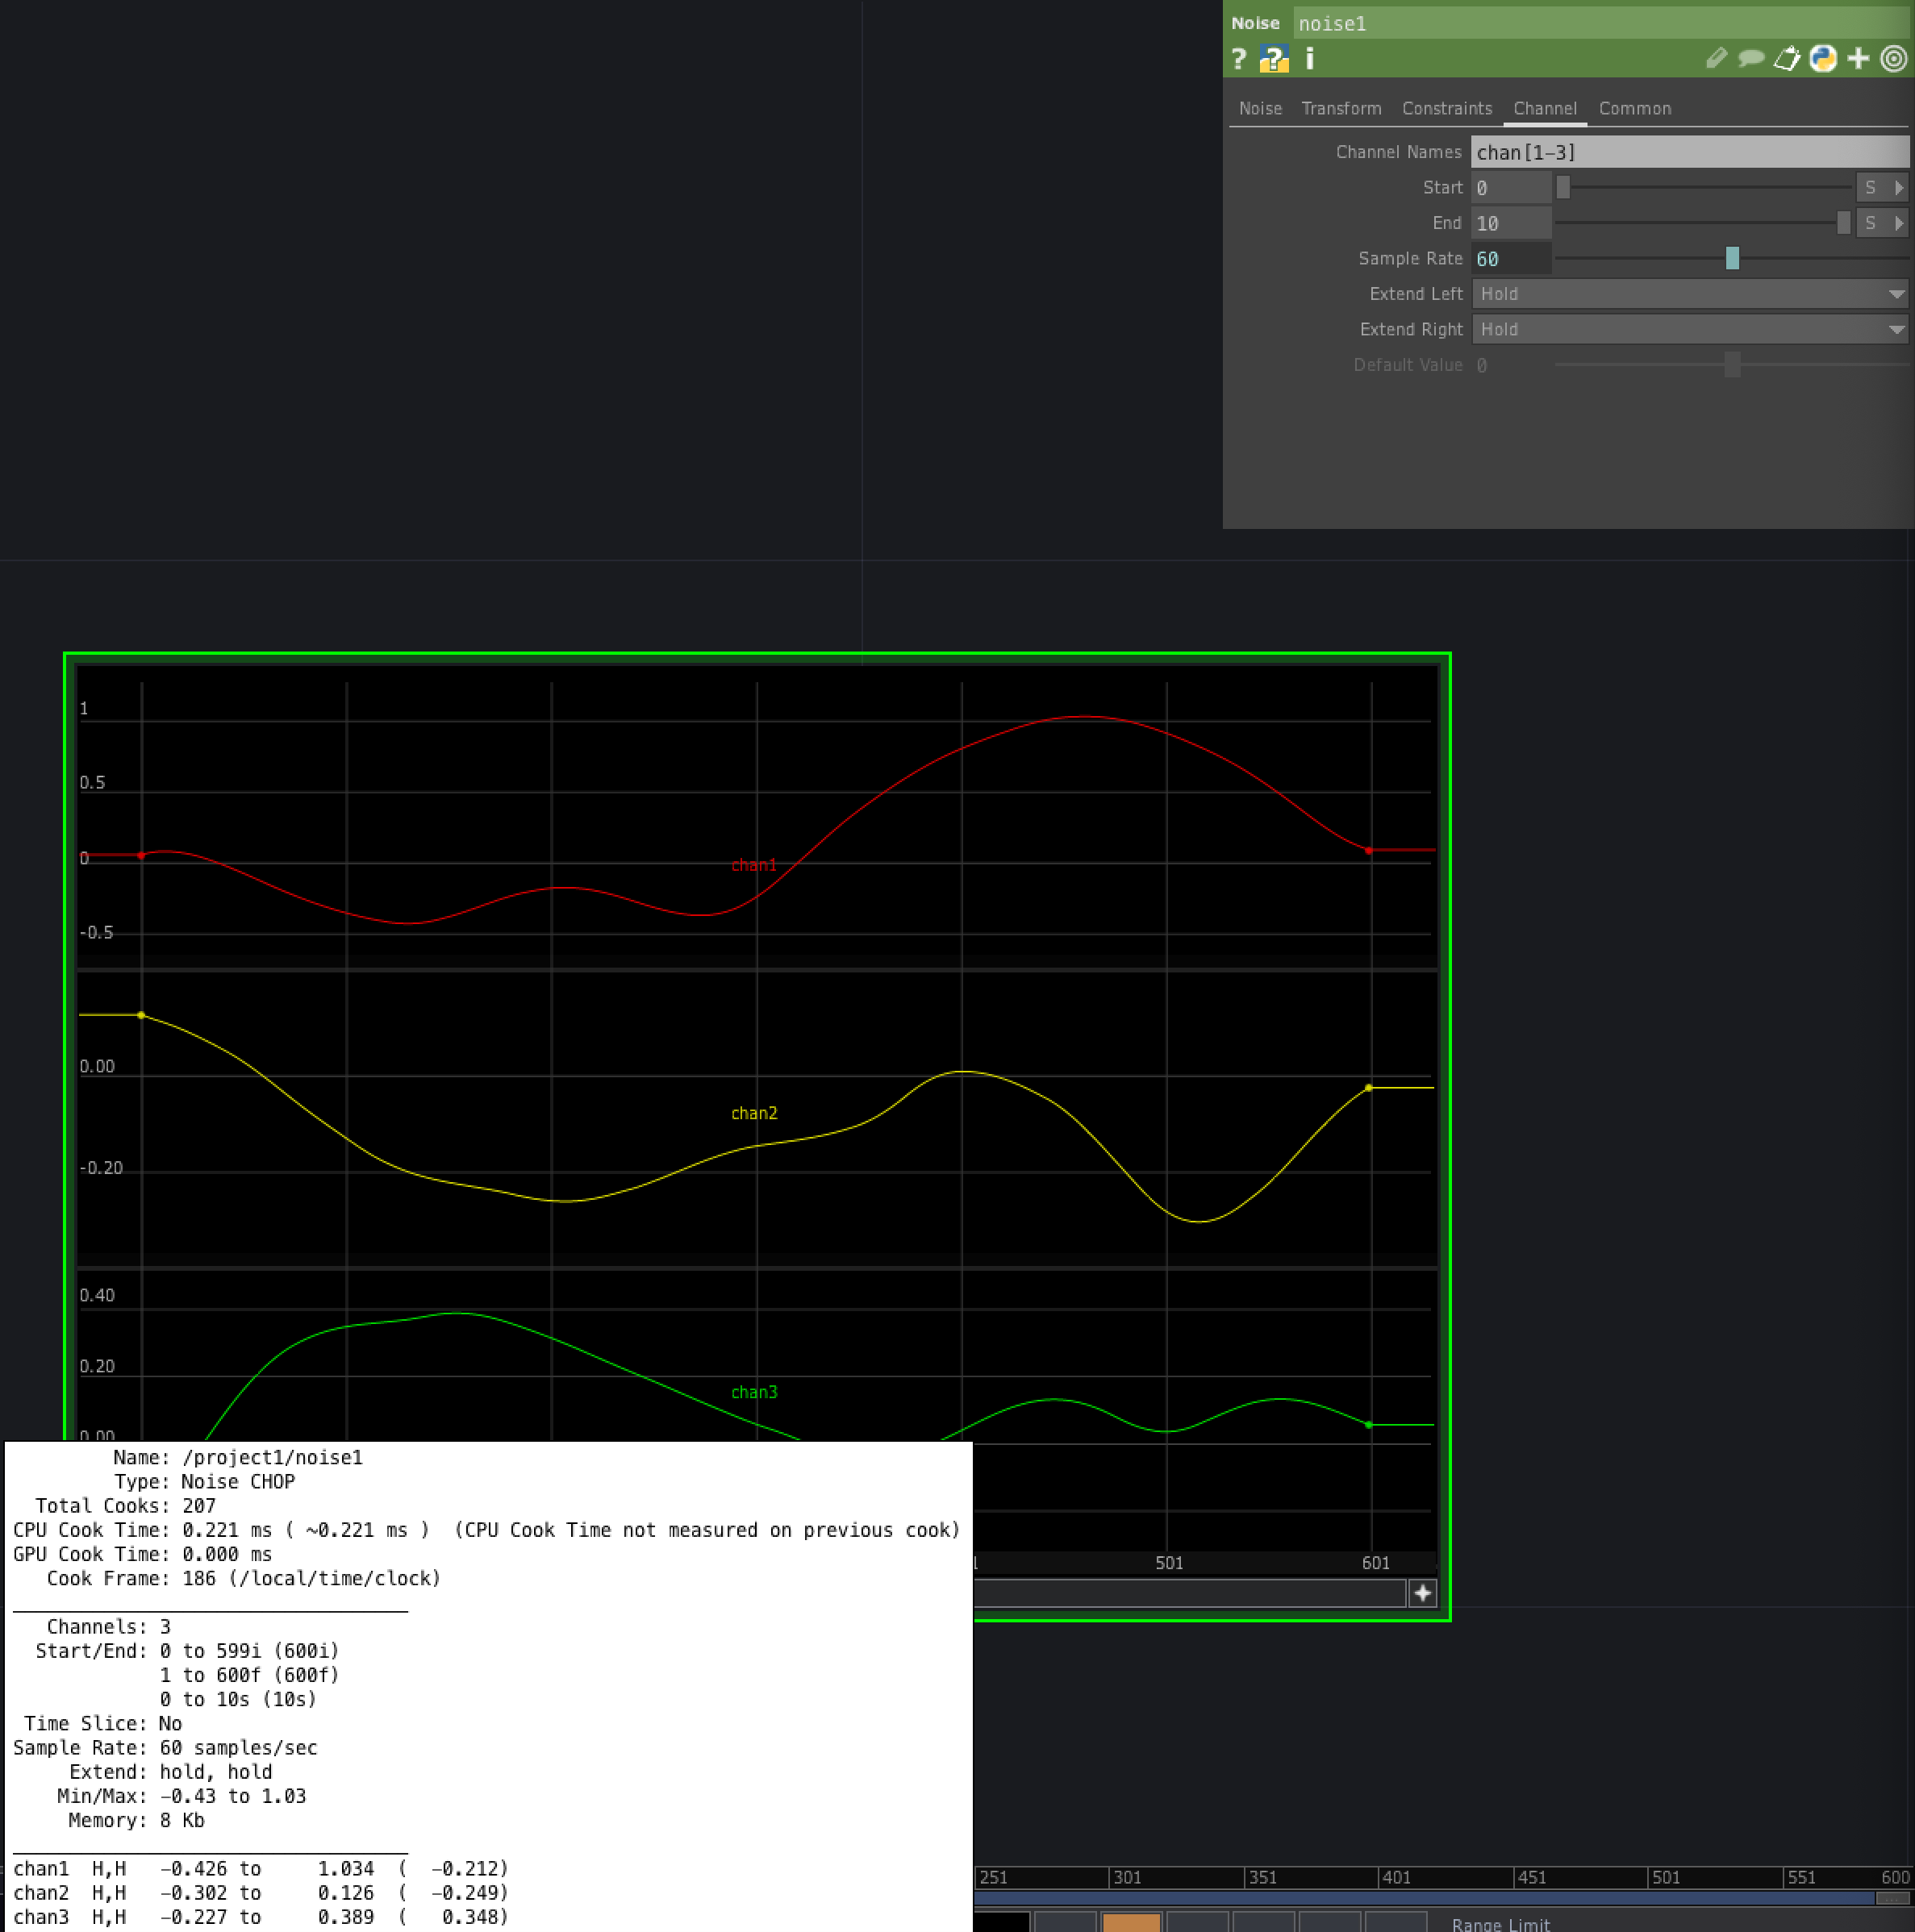
Noise CHOP can have multiple channels
Can add multiple channels to a Noise CHOP by changing Channel Names parameter to an array
E.g., chan[1-3] produces three channels, each with 600 samples
You can verify this by looking at the info dialog, where it states that Start/End is 0 to 599i

Slide 31
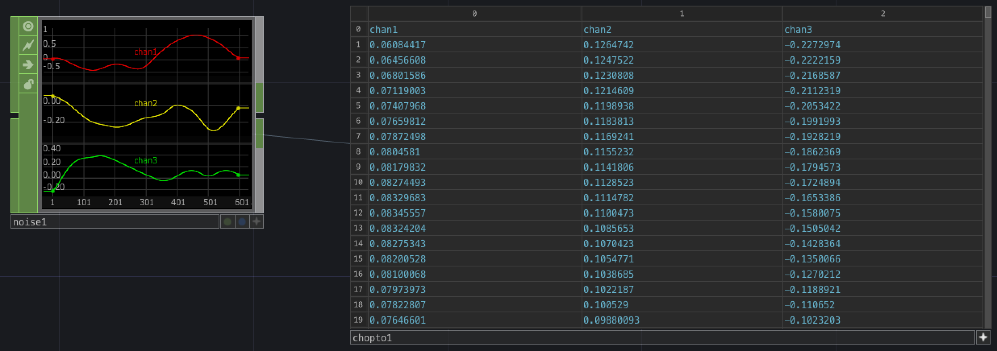
Using a “CHOP to” DAT to view the values generated by a CHOP
To view the sample values generated by a CHOP
Add a “CHOP to” DAT to your network
Drag the Noise CHOP onto the new CHOP to DAT
You’ll see a table in the DAT showing all the values generated by the Noise DAT
If you turn the “Include Names” toggle off, then the column headers are not included
You can do the same with, for example, a Constant CHOP
CHOPs generate and process signals that can represent a wide variety of different things, such as motion, audio or a control signal from an external device (e.g., a Leap Motion or a Kinect)

Slide 32
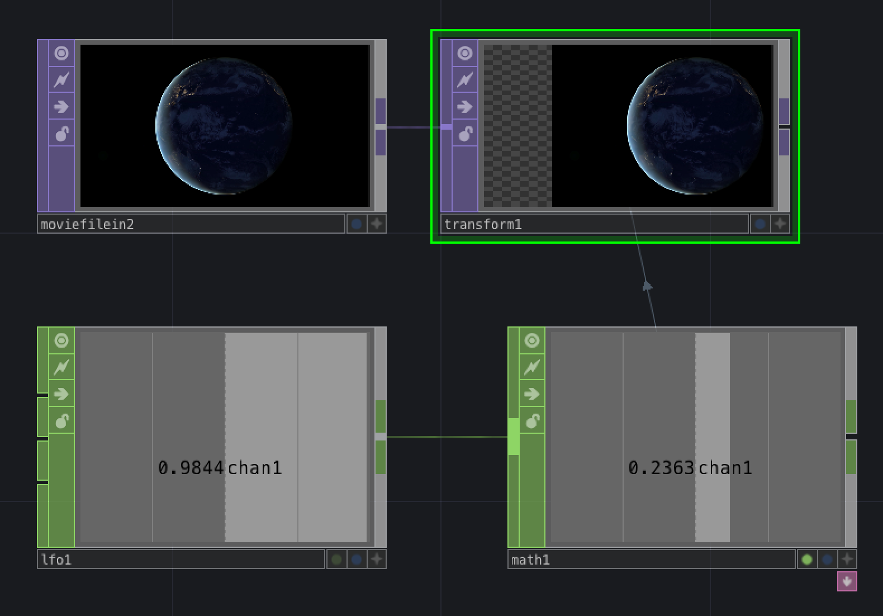
Exporting CHOP channels to operator parameters
We’ll use the values generated by an LFO CHOP to translate a movie from side to side
We’ll need an LFO CHOP, a Math CHOP, a Movie File In TOP and a Transform TOP
Select an input file for the Movie File In TOP
Connect the Movie File In TOP to the Transform TOP
Connect the LFO CHOP to the Math CHOP
Make the Math CHOP’s viewer active
Select the Transform TOP so you can see its parameters
Click on the Math CHOP’s viewer and drag to the Translate parameter of the Transform TOP
Select “Export CHOP” from the pop-up menu that appears
Adjust the range of the output of the Math TOP by going to its Mult-Add page and adjusting the Multiply slider
Adjust the speed of the oscillation by changing the value of the frequency parameter of the LFO
You can stop the export by clicking on the Export flag (green dot) at the bottom of the Math CHOP

Slide 33
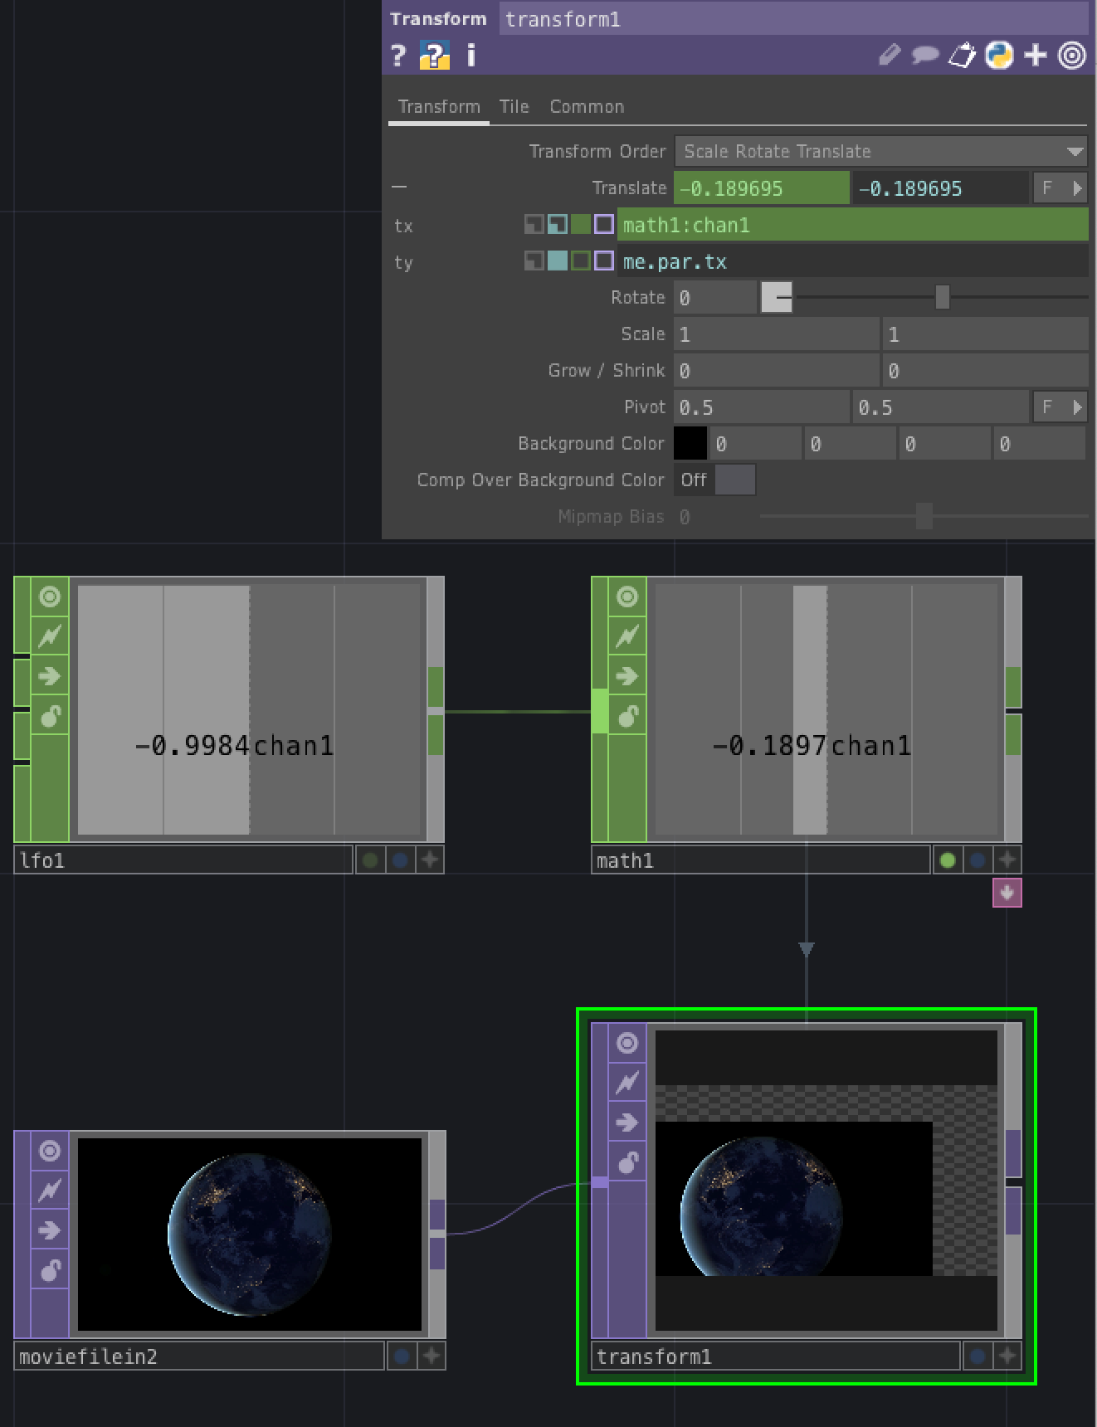
Using Python expressions in parameters
Expressions can be used instead of channels or constant values in parameters and scripts
The preferred language is Python
If we click on the name of the Translate parameter of the transform1 TOP, we see that the tx variable gets its values from math:chan1 – this is the export from chan1 in the math1 Math CHOP
The fact that this is an export is indicated by the filled green square to the left of the value text box
Now let’s put an expression in the ty variable, e.g., 0.2 ** 2, which means the square of 0.2 in Python
You’ll see that the blue box is filled to the left of the value, indicating that this is now a Python expression
Change the expression in ty to me.par.tx to have the movie also oscillate up and down at the same rate as it moves from left to right
Access the value of a parameter in the same OP using me.par.name where name is the name of the Python variable associated with the parameter
See https://derivative.ca/UserGuide/Python_Tips for some commonly used techniques for using Python expressions in TouchDesigner

Slide 34
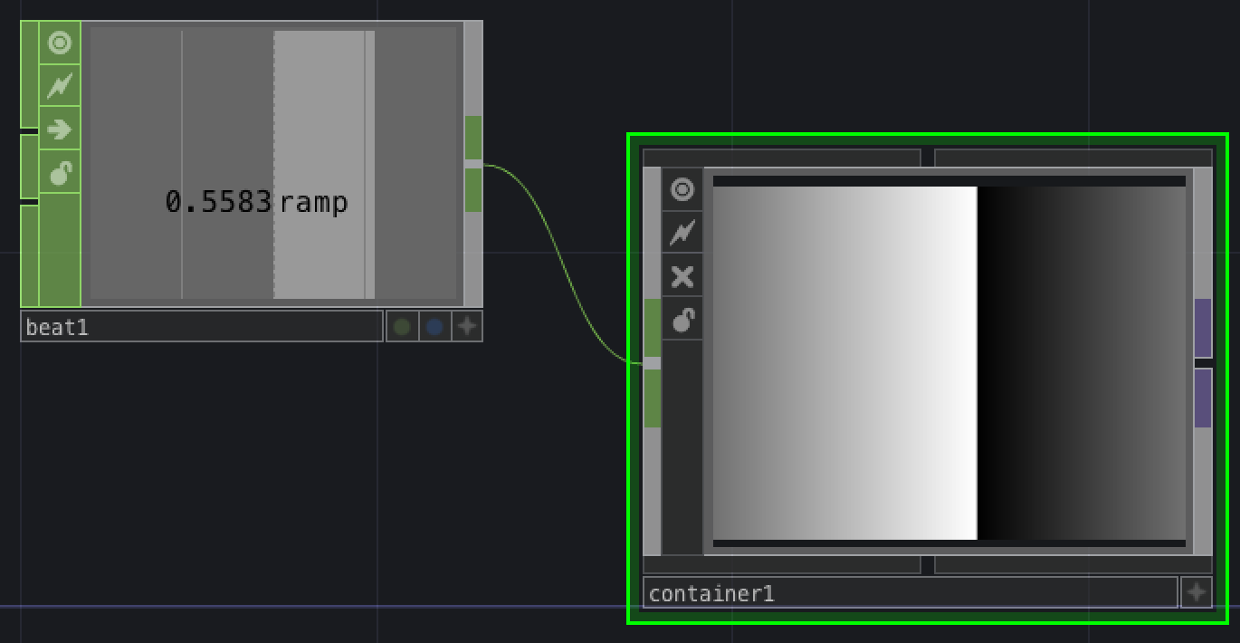
Components with inputs and outputs
Each component operator contains an entire network of nodes
A component can take an input and generate an output
Let’s create a custom Component that takes a CHOP input and generates a TOP output
First we create a Container COMP
Inside the Container CHOP we place a Ramp TOP
Connect the output of the Ramp TOP to the input of a new Out TOP
Place an In CHOP inside the Container COMP
Go back outside the Container COMP
Create a Beat CHOP and connect its output to the input of the Container COMP
Go back inside the Container COMP – see that the In CHOP is now receiving input from the Beat CHOP outside the container
Export the In CHOP channel to the Phase parameter of the Ramp TOP
Go back outside the Container COMP
On the Container’s Look page, set the Background TOP parameter to be the name of the Out TOP that it contains – indicate this with its path, ./out1

Slide 35
Node paths
Node paths work just like paths in file systems, except that operators correspond to files and components correspond to folders
The address bar shows the path to the network being shown in the network editor
Click on the home button to take you to the root component (‘/’)
So:
/ is the root component – an absolute path begins with the forward slash
A path that does not begin with a forward slash is a relative path – it tells you how to get to the selected node or network from your current position
./ is the current component, so ./out1 means the node called out1 in the current component
../ refers to the parent component, so ../chopto1 means the node called chopto1 in the parent network – i.e., you need to go ‘up’ one network and there you will fine chopto1
Just giving a node name, e.g., transform1, identifies the node with that name in the same network as the node where the path is being written

Slide 36
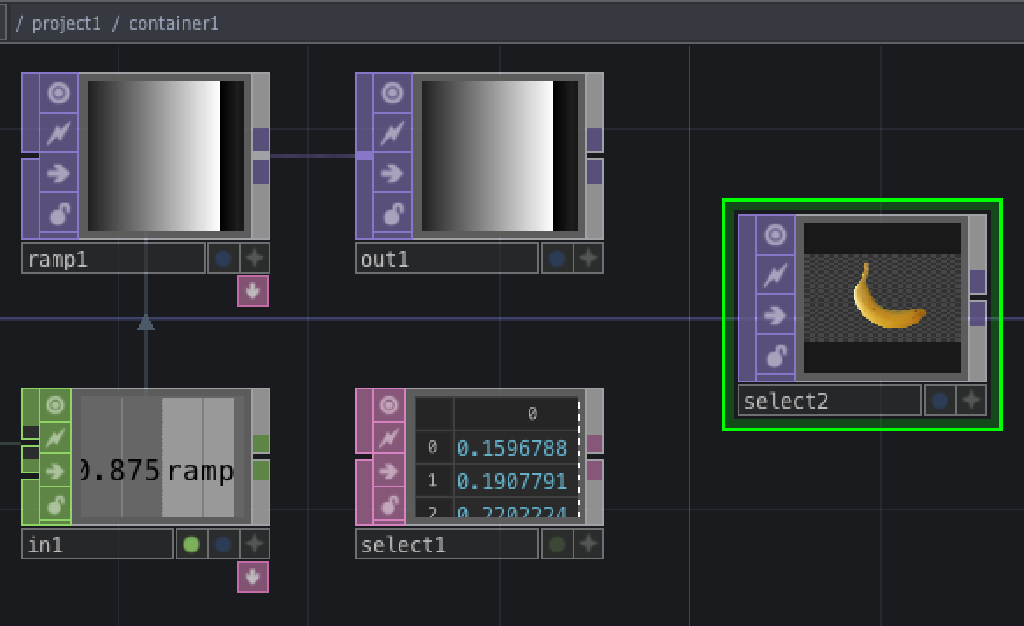
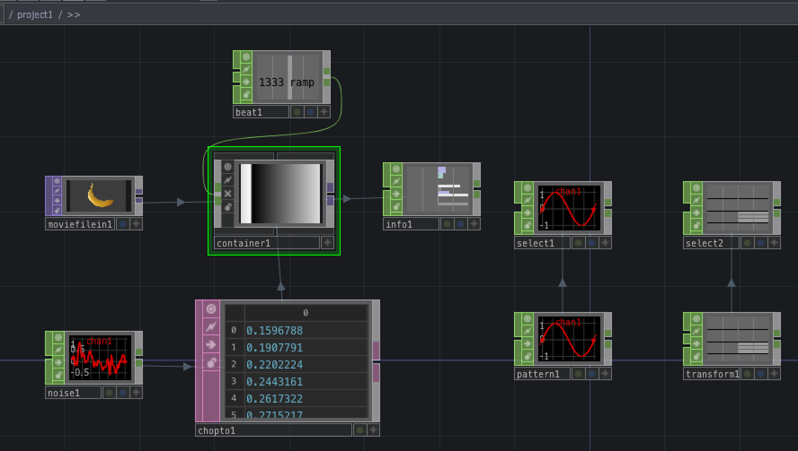
Some practice with node paths
select1 CHOP refers to another CHOP – if you write /project1/pattern1 in the CHOP parameter, this is the absolute path to the pattern1 node
select2 TOP refers to a TOP – set its TOP parameter to transform1 to refer to the transform1 node using a relative path
info1 CHOP gives information about an operator – set its operator path to container1/out1 to get it to show info about the out1 TOP inside the container1 COMP, which is in the same network as the info1 CHOP
container1 has its Background set to ./out1, which refers to the out1 TOP inside it
select1 DAT inside container1 has its DAT parameter set to ../chopto1 which is a relative path referring to the chopto1 CHOP in the network containing container1

Slide 37
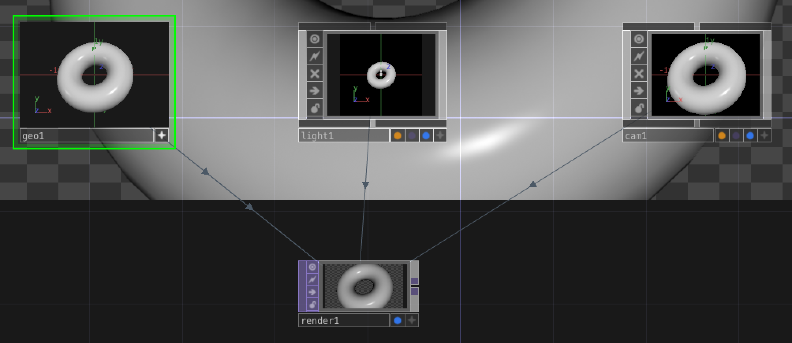
Rendering a 3D scene
You render a 3D scene by using a Render TOP that takes input from Geometry, Light and Camera components
By default, Render TOP has following values for Camera, Geometry and Lights:
Camera: cam1
Geometry: * (all in current network)
Lights: * (all in current network)
When you add Camera, Lights and Geometry components, Render TOP automatically establishes connections with them

Slide 38
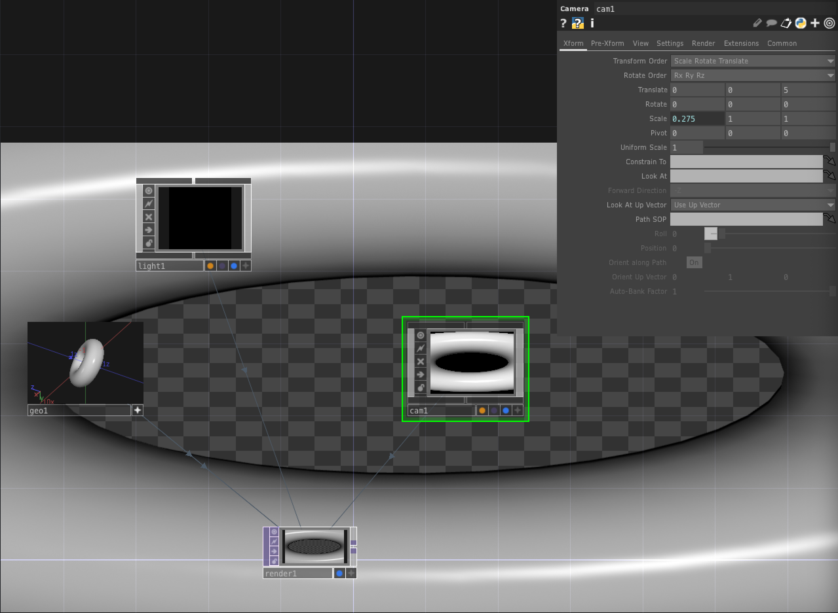
Rendering a 3D scene
You can change parameter values of the Geometry component to transform it by translation, rotation, scaling etc.
Note that tumbling the geometry in an active viewer does not change the rendering
Experiment with using absTime.frame to continuously change angle of rotation
You can also carry out geometric transformations on Lights and Cameras.

Slide 39
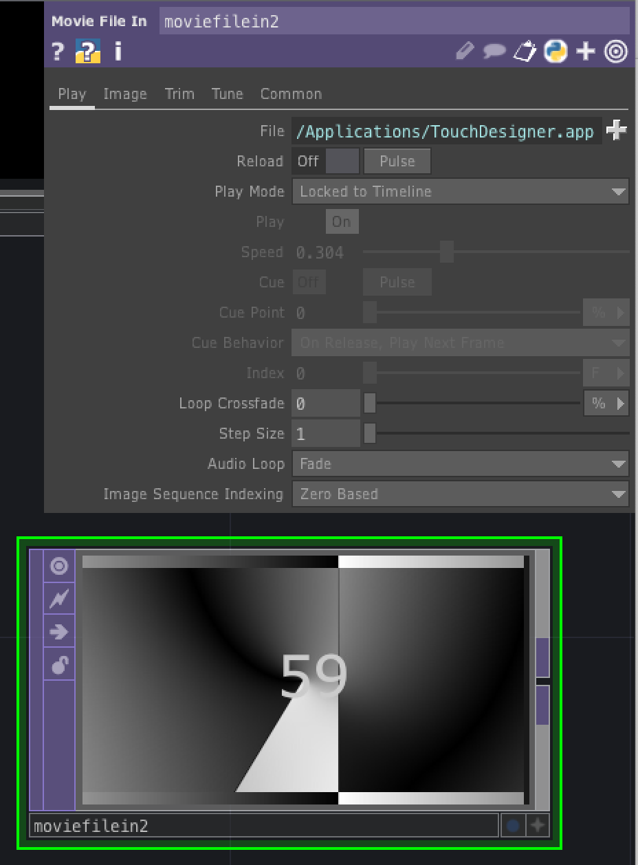
The Timeline
FPS in bottom left corner of Timeline is number of frames TD tries to advance per second
Actual FPS is given at the top of the screen and may be less because of time taken to carry out processing
The Timeline lets you play (>), reverse play (<), pause (||) and step forward (+) or backward (- )
Spacebar toggles play and pause
Timeline loops back when it reaches the end, but TD is mainly event-driven with a free-running clock, so what you build does not need to be bound to the time-line
e.g., a constant CHOP, set to 1, connected to a Speed CHOP increases continuously, Speed CHOP restarts when you press its Reset parameter
Place a Movie File In TOP and have it load the count.mov movie
By default, play mode is Sequential, which means movie is not tied to the Timeline
If you change play mode to “Locked to Timeline”, you’ll see that it restarts when the Timeline restarts

Slide 40
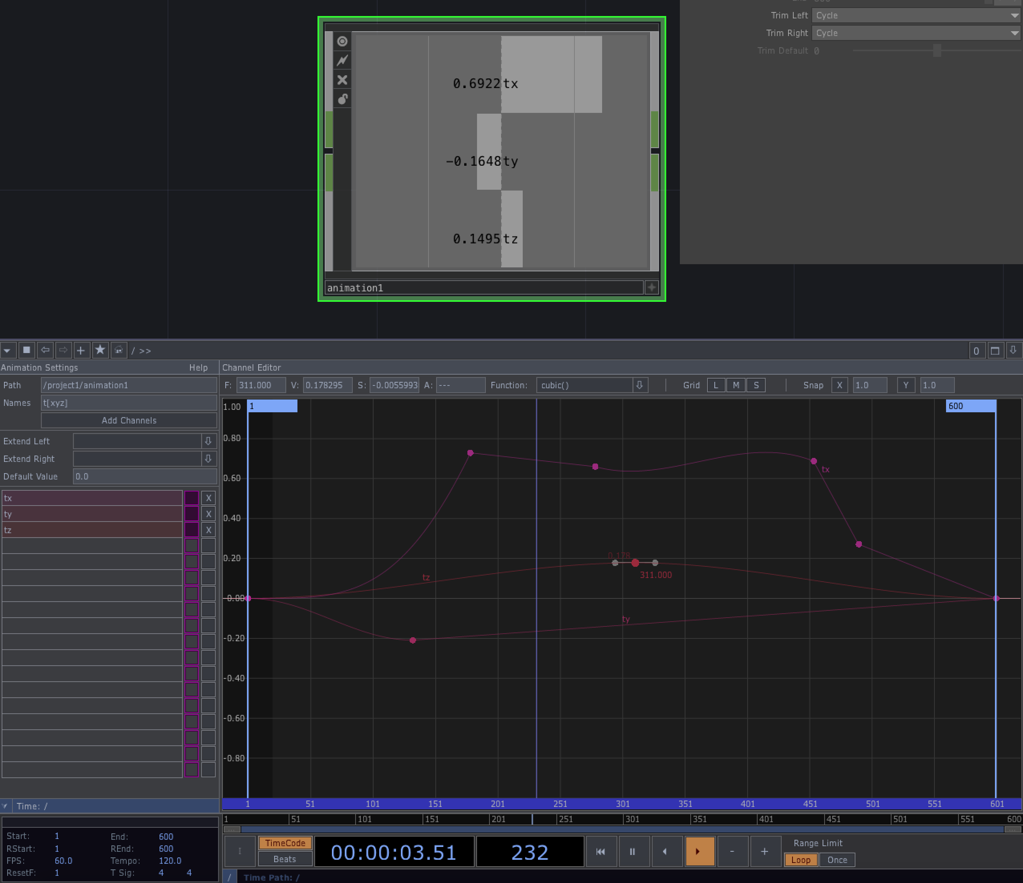
Using the Animation Editor
Create Animation Component, right click and select “Edit animation”
Click “Add Channels” – three channels are added, tx, ty and tz
Each channel has 600 frames by default if the Type parameter on the Range page of the properties is set to “Timeline”
Keyframes are indicated by dots on the channel lines in the editor
Add a keyframe by pressing Alt-LMB on a channel curve
Control type of interpolation between two consecutive keyframes by selecting that segment of the curve and selecting the type from the Function drop-down box
You can watch the changing values in the channels in the Animation component’s viewer

Slide 41
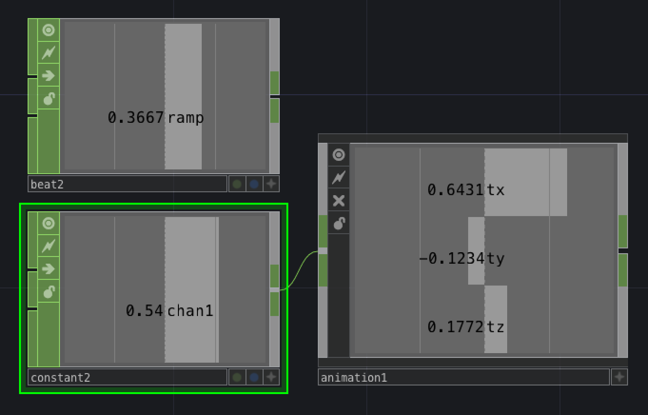
Controlling animation index with an input channel
We can control the speed of an animation independently of the Timeline by connecting a CHOP to the Animation Component’s input
Set the Play Mode of the Animation COMP to “Use Input Index” and the “Input Index Unit” to Fraction
Connect a Beat CHOP to the input of the Animation Component
You can change the speed by changing the Period parameter of the Beat CHOP
Now connect a Constant CHOP to the input of the Animation COMP
You can now scrub through the animation using the chan1 property slider in the Constant CHOP

Slide 42
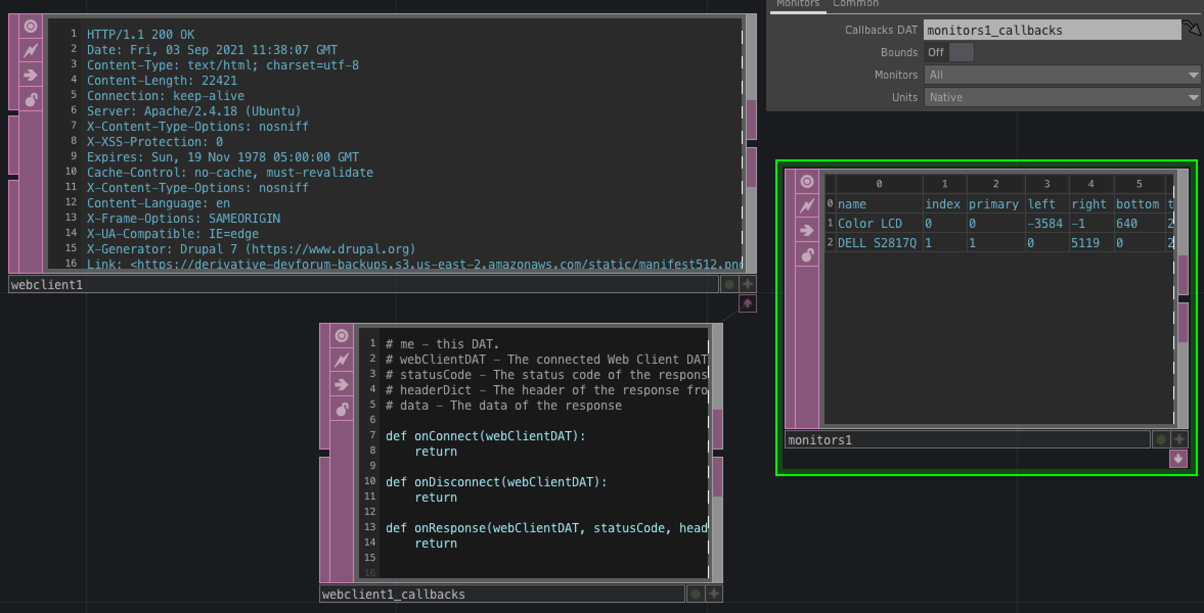
DATs are powerful text-manipulation operators
Data Operators (DATs) let you store and manipulate text in your networks
DATs can be used to hold scripts that run when an event occurs
For example,
create a Web Client DAT and press the Request button – the DAT loads the HTTP Response sent from the server whose URL is given in the URL parameter
Create a Monitors DAT – shows information about the monitors currently connected to the system
If you click on the pink button at the bottom of the node, it shows some call back functions that you can override to customize the behaviour of the DAT

Slide 43
Sweet Sixteen Operators
If you bring up the OP Create Dialog, you’ll see that there are hundreds of operators
But typically you’ll only use a small subset of these
There’s a set of “Sweet Sixteen” operators for each operator type that are the ones that Derivative thinks are the most commonly used
We’ll work through these Sweet Sixteen operators over the coming lectures so that you have a chance to familiarize yourself with them

Slide 44
Operator snippets
TD comes with a large library of small example networks that illustrate the use of individual operators
You can access this library of Operator Snippets from the Help Menu
This opens a new TD window with a palette on the left where you can select from hundreds of small examples

Slide 45
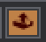
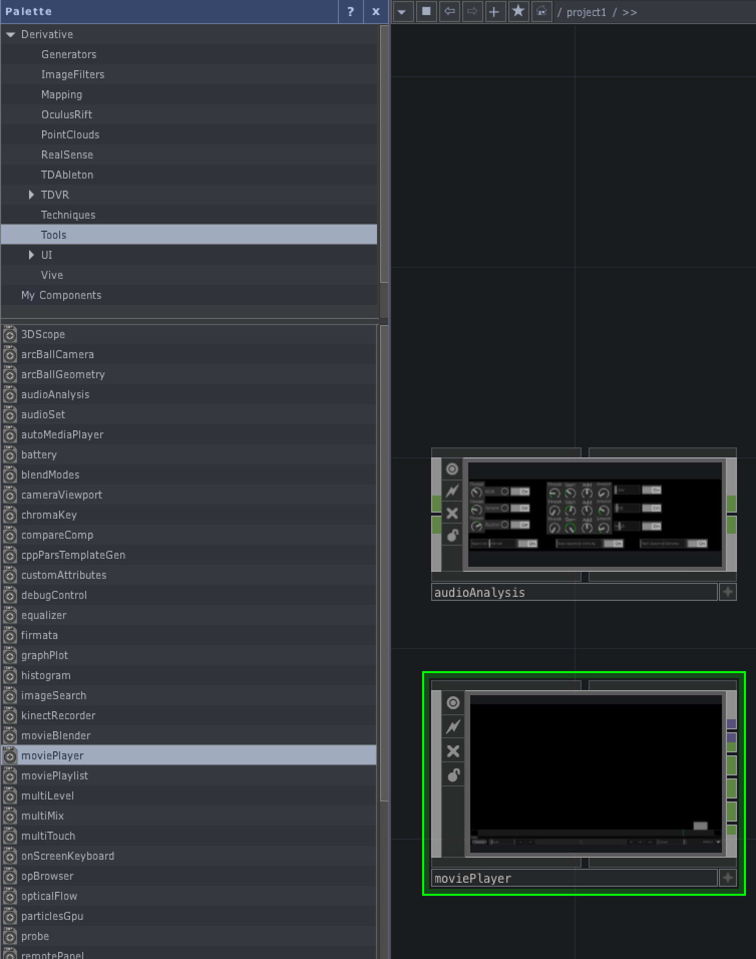
Getting pre-made components
You can get pre-made components from the Palette Browser
Open the Palette Browser by clicking on the button at the top left of the main window or with the Alt-L shortcut
You can also store your own components in the Palette
Components can be stored as .tox files for interchange
UI/gal gives a gallery of 20 pre-made customizable gadgets for building control panels
You can also get components from the Shared .TOX Components Forum
https://forum.derivative.ca/c/shared-tox-components/12

Slide 46
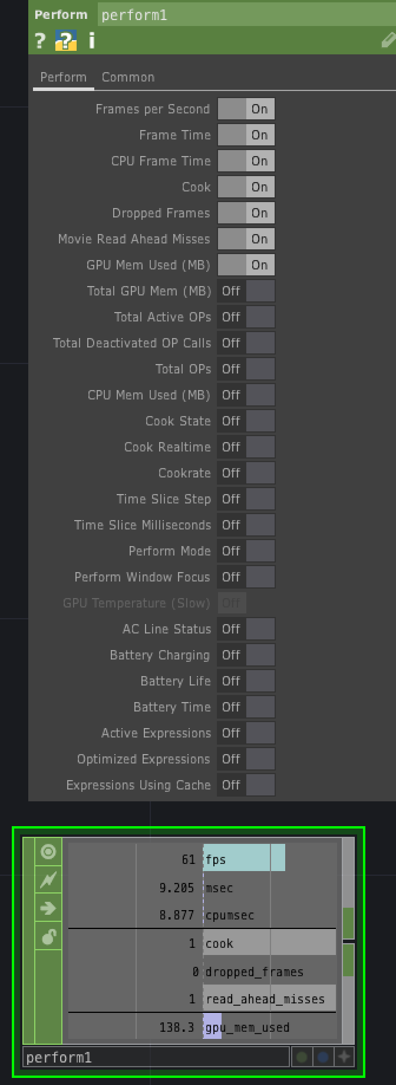
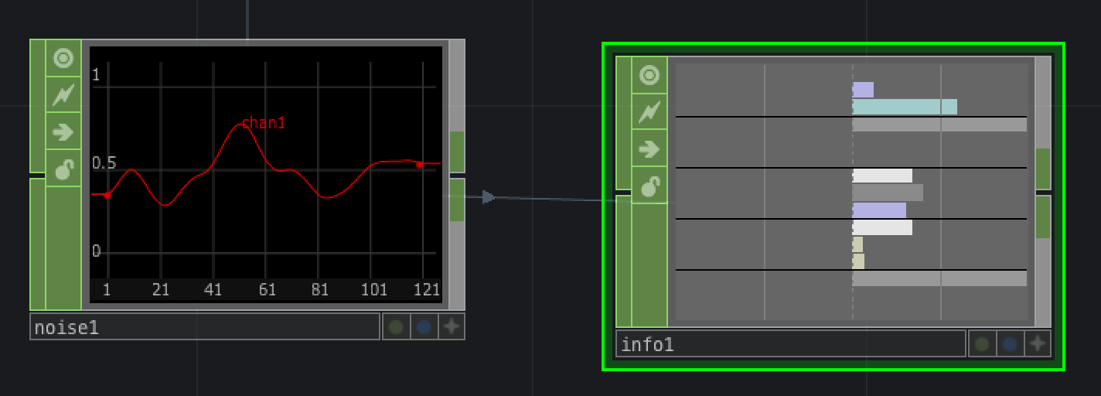
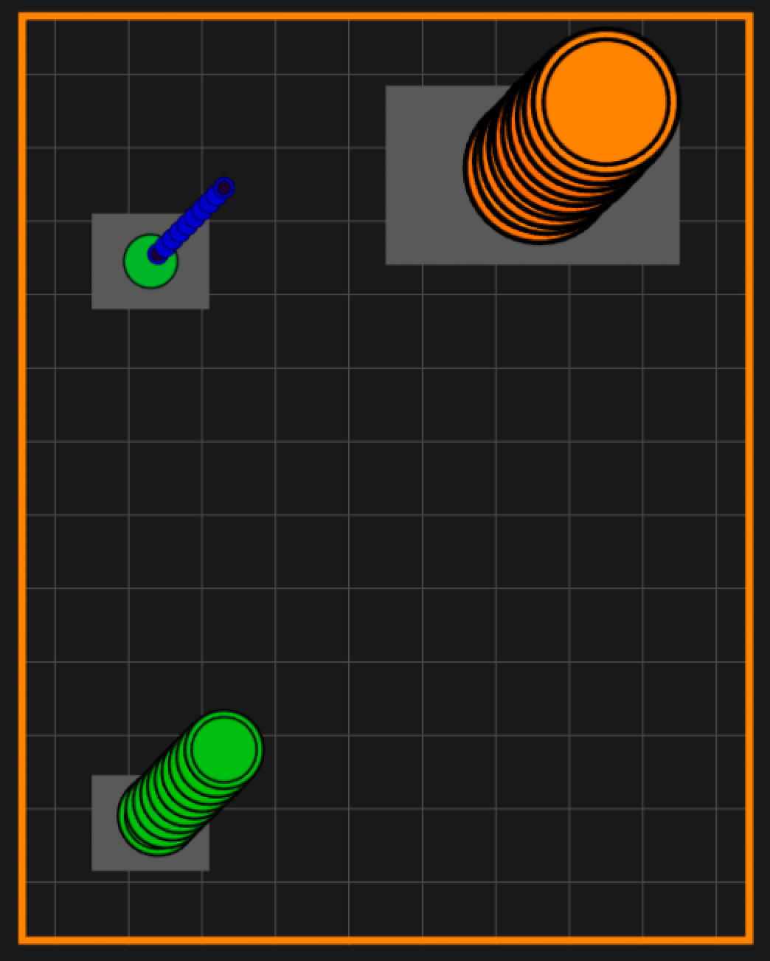
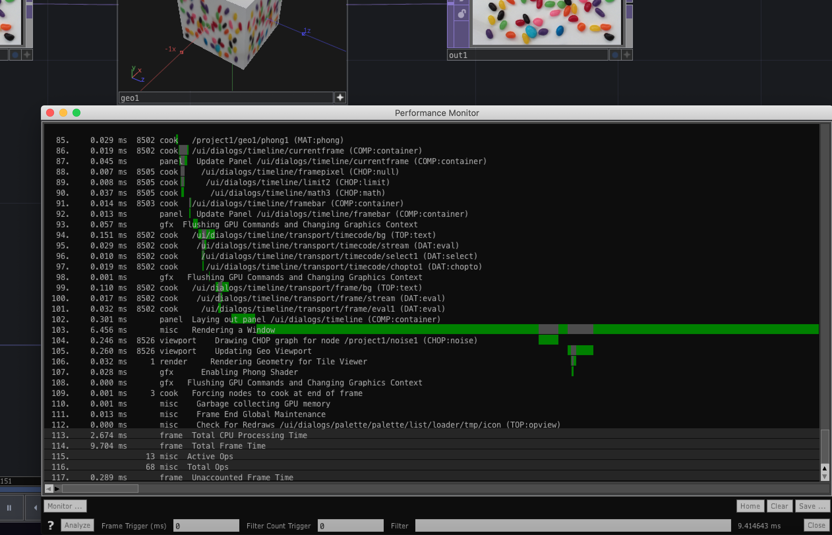
Monitoring the performance of your network
Dialogs -> Performance Monitor
Click on Analyze to get a detailed analysis of the activity of the network over the course of a single frame – shows which nodes cooked and how long they took
NB only reports on CPU activity
Middle-click on a node to see whether it is cooking and how much processor time it is using
The Perform CHOP shows a real-time graph where you can decide which information is shown
The Info CHOP can be used to show real-time info on any node that you drop on it
The Probe (Palette > Tools > Probe) gives you a graphical display of the activity in your network

Slide 47
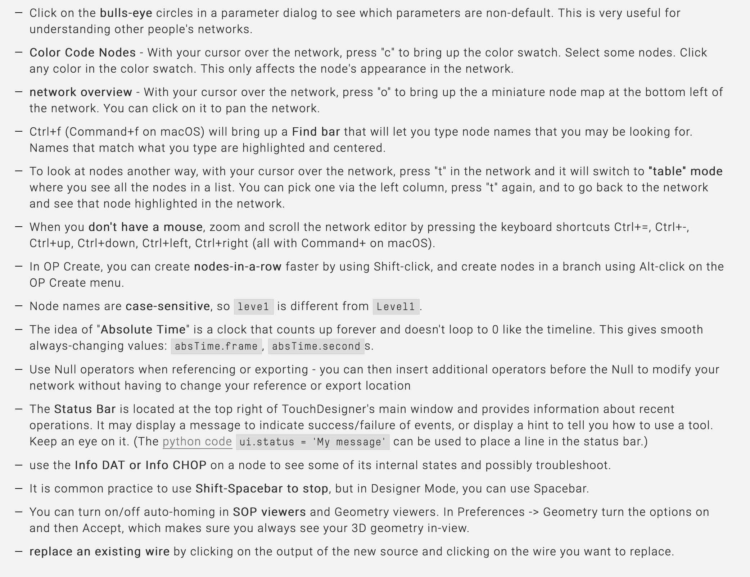
Some quick tips and good habits

